Slide 1




Temperature and Humidity control in an Evaporative Cooling based AC system for Residential Applications
Final Report– MENG 5330 Process Control
December 7, 2023
Giovanni Josue Cerrato
Gideon Kwabena Nyarko
Amrit Thapa

Slide 2
Outline of report
Content | Slide number
Introduction | 1
Background | 2
Motivation | 4
Objectives | 5
Methodology | 6
Results and Discussion | 8
Conclusion | 19
References | 20
Appendices | 22

Slide 3
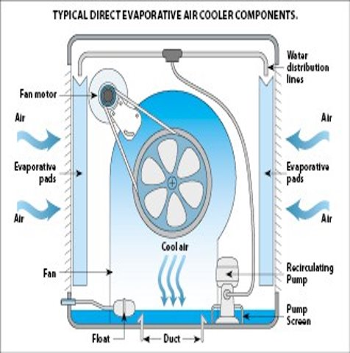
Introduction
An evaporative cooler (EC) is a device that cools air through the evaporation of water using a heat and mass transfer process.
Evaporative cooling differs from vapor-compression based AC systems by
Consuming less energy
Being more environmentally friendly
Optimal performance in hot and dry climate conditions¹
This project will focus on a direct evaporative cooling AC system with a desiccant wheel for temperature and humidity control.
Fig 1. Operation of the Evaporative cooling system.³

Slide 4
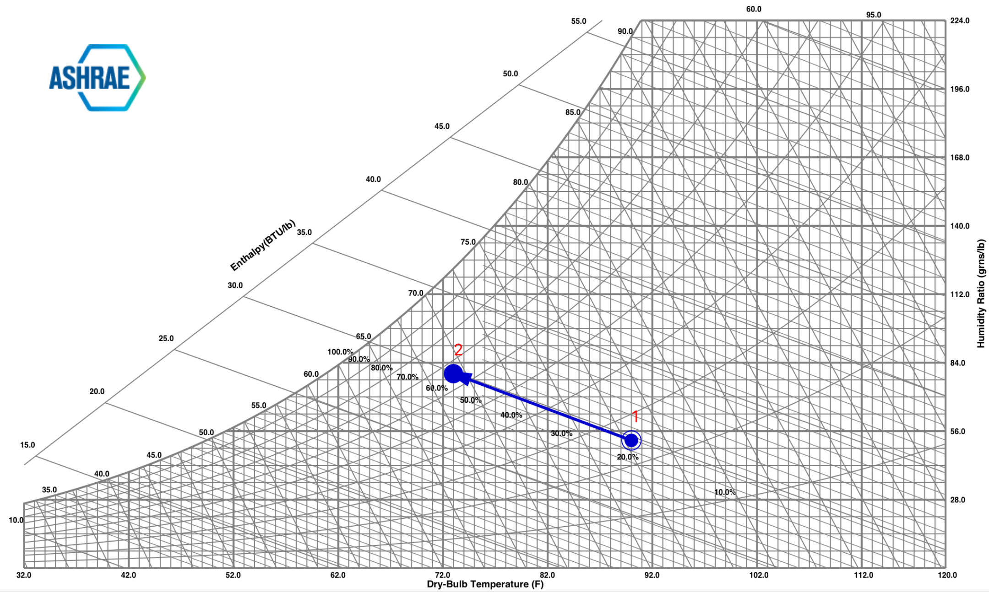
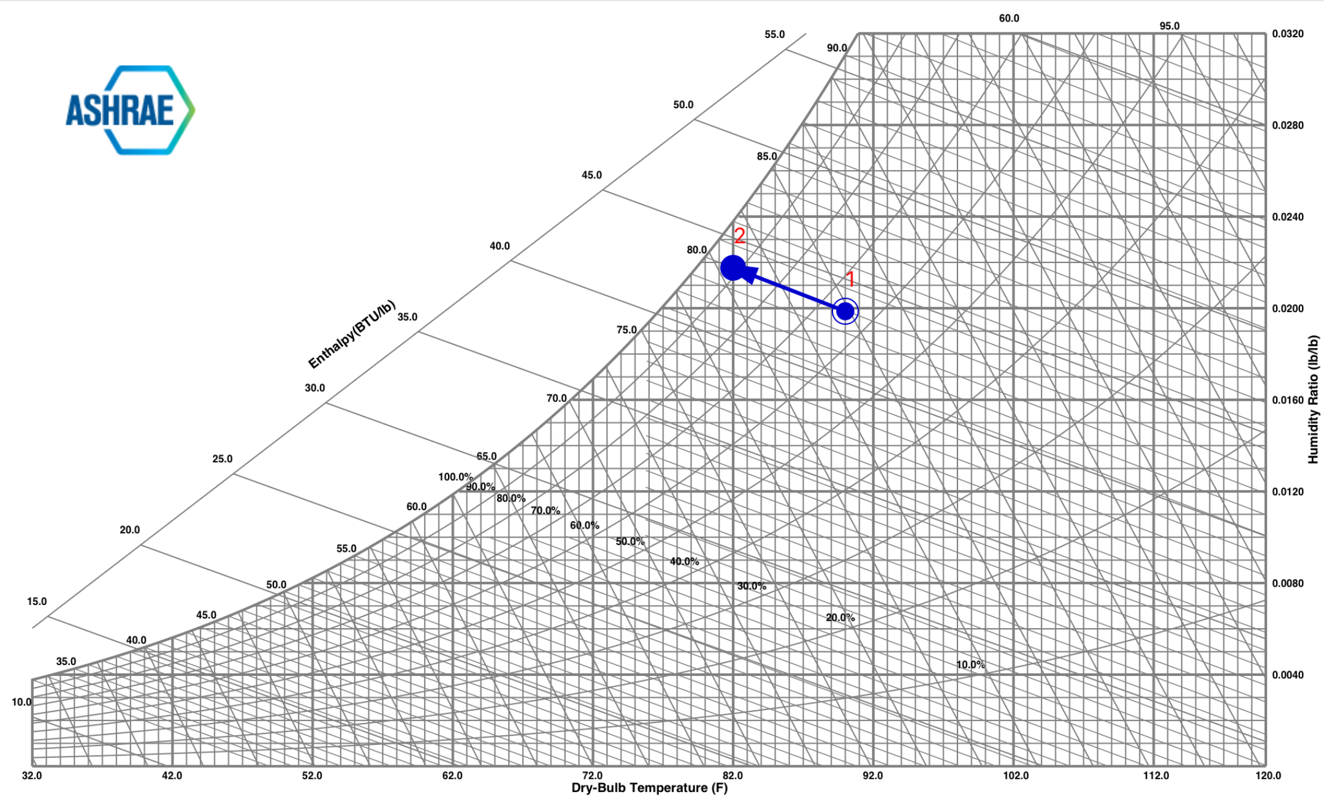
Background
Cooling Effect of an Evaporative Cooler (EC):
An EC cools the air by adding humidity to the air at a constant wet bulb temperature^{.1}
As air passes through the EC, evaporating water cools the air due to the latent heat of vaporization.
Effect of Relative Humidity on EC Effectiveness:
EC systems are less effective at higher humidity levels, reducing their cooling potential due to limited evaporation. (See Figure 3, compared to Figure 2.)
Fig 2. Evaporative cooling (low humidity) psychometric process
Fig 3. Evaporative cooling (high humidity) psychometric process
Notes:
M.R. Islam, K.A. Jahangeer, K.J. Chua, Experimental and numerical study of an evaporatively-cooled condenser of air-conditioning systems, Energy. 87 (2015) 390–399. https://doi.org/10.1016/j.energy.2015.05.005 P.M. Cuce, S. Riffat, A state of the art review of evaporative cooling systems for building applications, Renew. Sustain. Energy Rev. 54 (2016) 1240–1249. https://doi.org/10.1016/j.rser.2015.10.066.

Slide 5
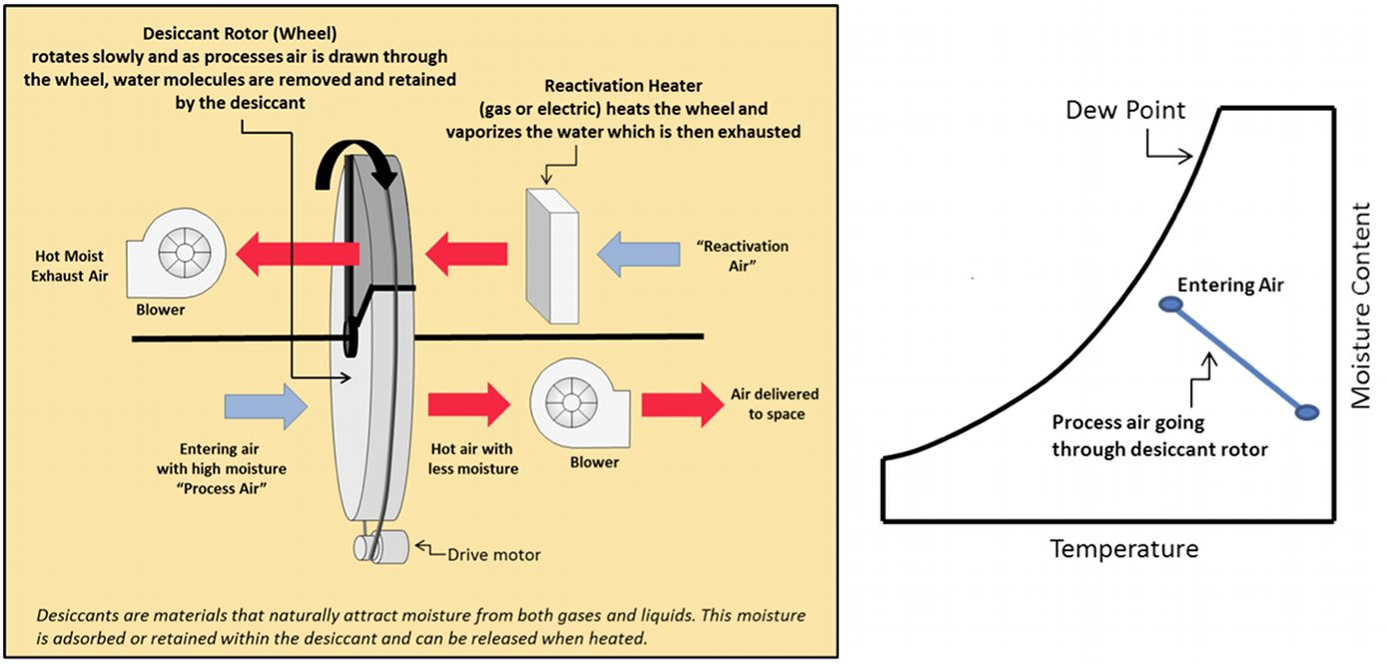
Background
Combining EC with a Desiccant Wheel (DW):
The integration of a rotating desiccant wheel to enhance EC performance has been explored in various studies ⁶⁻⁹ to achieve significant humidity reduction and control.
A desiccant wheel is a device that removes moisture from the air, by absorbing it onto the desiccant material.
Main types of desiccant wheel systems
Active
Passive
The one of choice for this project is the Active desiccant wheel (in Fig. 4) ¹⁰
Fig 4. Desiccant Wheel System⁹
Notes:
A. Beghi, L. Cecchinato, G. D. Mana, M. Lionello, M. Rampazzo, and E. Sisti, “Modelling and control of a free cooling system for Data Centers,” Energy Procedia, vol. 140, pp. 447–457, 2017, doi: 10.1016/j.egypro.2017.11.156.
Y. Lee, S. Park, and S. Kang, “Performance analysis of a solid desiccant cooling system for a residential air conditioning system,” Appl. Therm. Eng., vol. 182, p. 116091, 2021, doi: 10.1016/j.applthermaleng.2020.116091.
“How Active Dehumidification Works,” Building Green. https://www.buildinggreen.com/primer/how-active-dehumidification-works

Slide 6
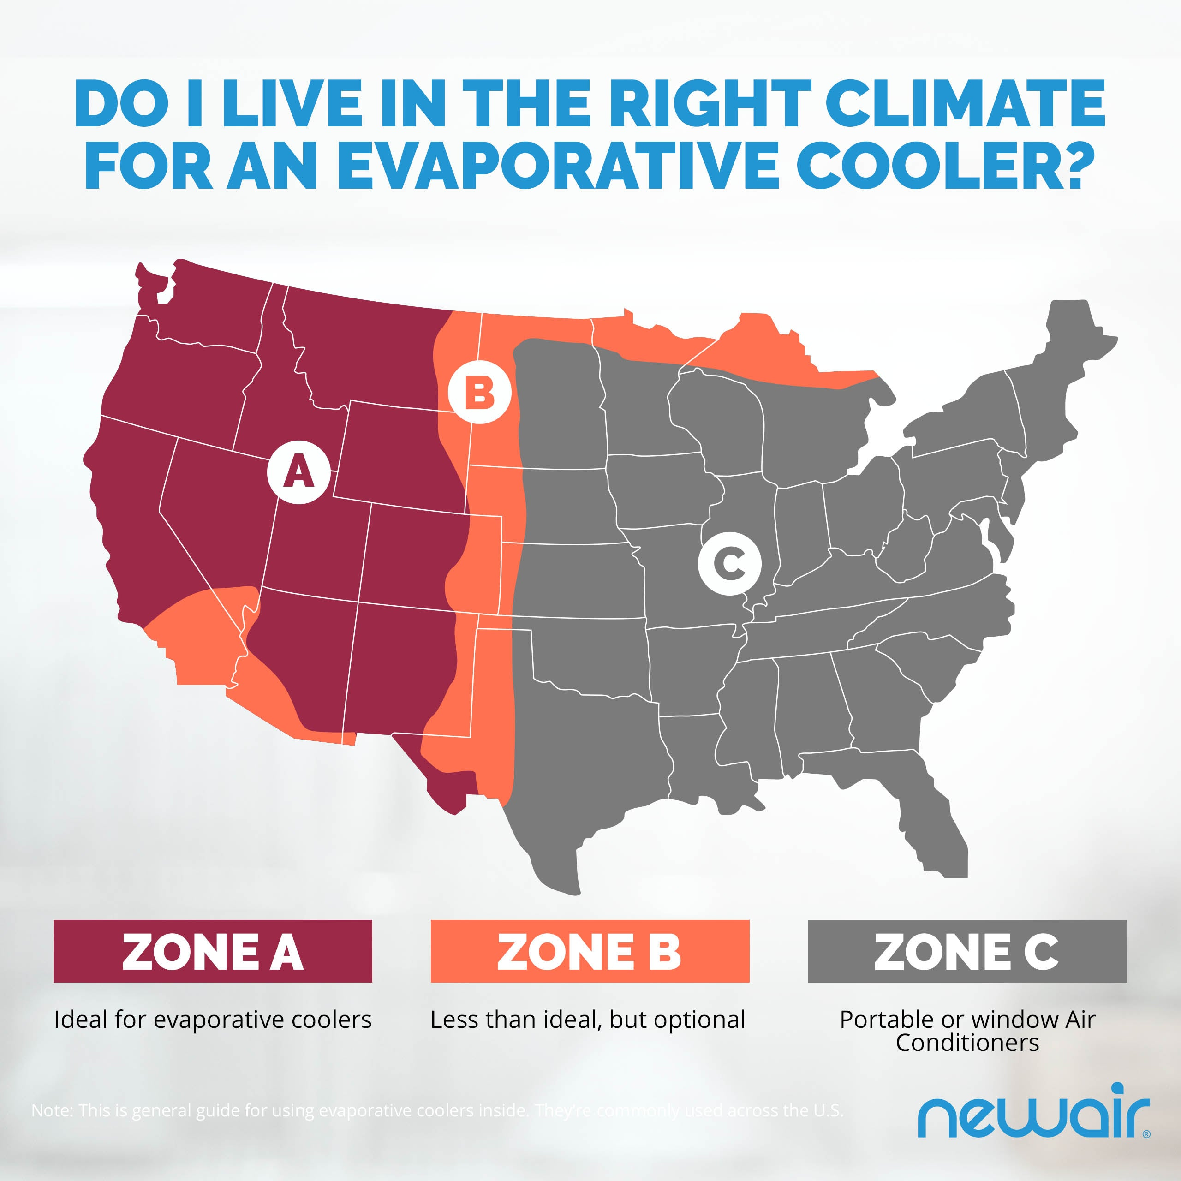
Motivation
Evaporative coolers known to work effectively, in reliably dry climates ².
But,
To improve its widespread usage for the diverse US climates, reducing carbon emissions and energy consumption.
What crucially can be done?
Design a closed-loop control system for residential evaporative cooling AC, managing both temperature and humidity, is currently unavailable in the market.
Fig 5. Efficiency of EC systems across the US.
Source: https://www.newair.com/blogs/learn/what-are-evaporative-coolers

Slide 7
Objectives
Develop a mathematical model governing the thermal system (house)
Design a combined evaporative cooling/desiccant wheel (EC/DW) MIMO system to regulate temperature and humidity in residential applications.
Assess and review energy savings by comparing the combined EC and DW system with a standard vapor-compression AC system.

Slide 8
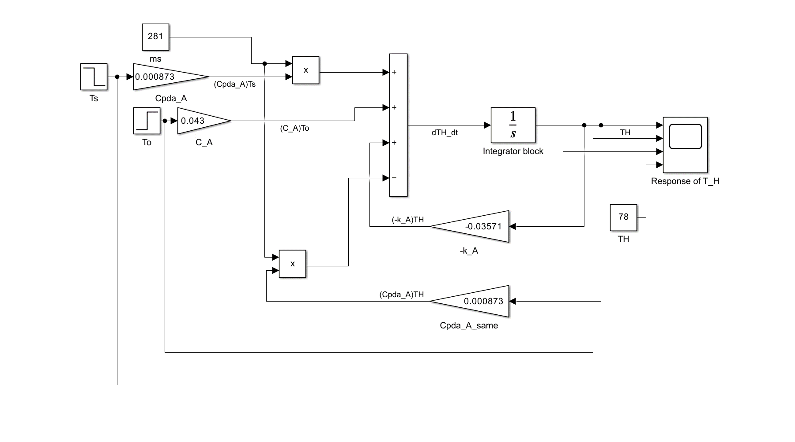
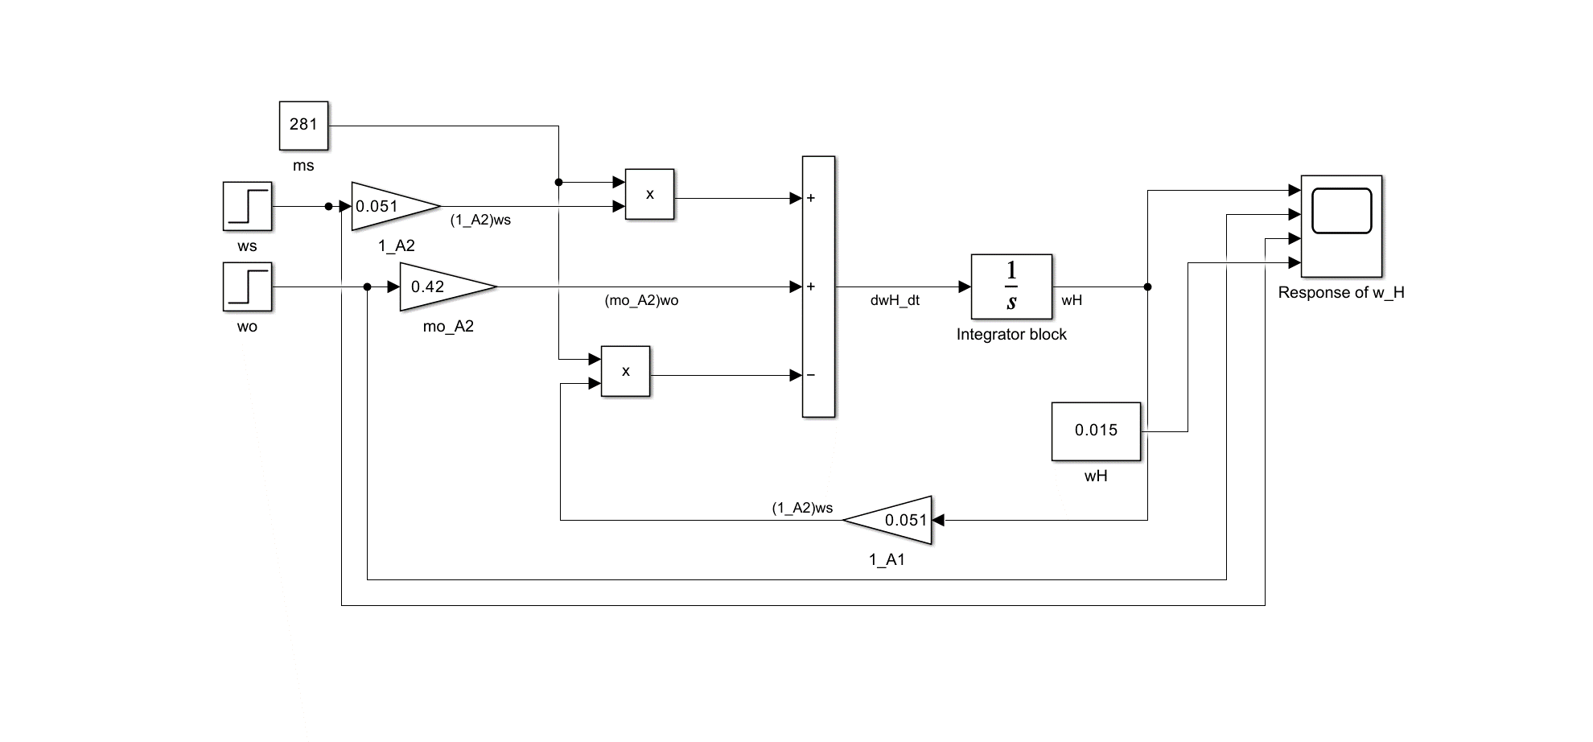
Methodology – Open-Loop Simulink Model
Open loop plant models for T_{H} and W_{H} of the house space based on the differential equations (ODEs) from system’s dynamic energy models for Dry Air and Water Vapor.
A. Dynamic Dry air energy equation
B. Dynamic Water Vapor energy equation
$$\frac{dT_{H}}{dt}=\frac{1}{ρ_{da}∀_{H}{Cp}_{da}}\left(k\left(T_{o}−T_{H}\right)+\dot{m_{s−da}}{Cp}_{da}T_{s}+\dot{m_{o−da}}{Cp}_{da}T_{o}−\dot{m_{r−da}}{Cp}_{da}T_{H}\right)$$
$$\frac{dw_{H}}{dt}=\frac{1}{ρ_{w}∀_{H}}\dot{\left(m_{s−da}\right)w_{s}+\dot{m_{o−da}}w_{o}−\dot{m_{r−da}}w_{H} }$$
Fig 6. T_{H} for Open Loop Plant
Fig 7. W_{H} for Open Loop Plant

Slide 9
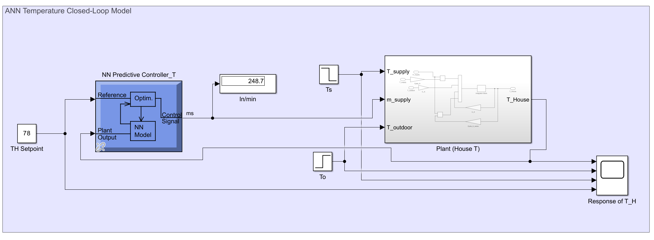
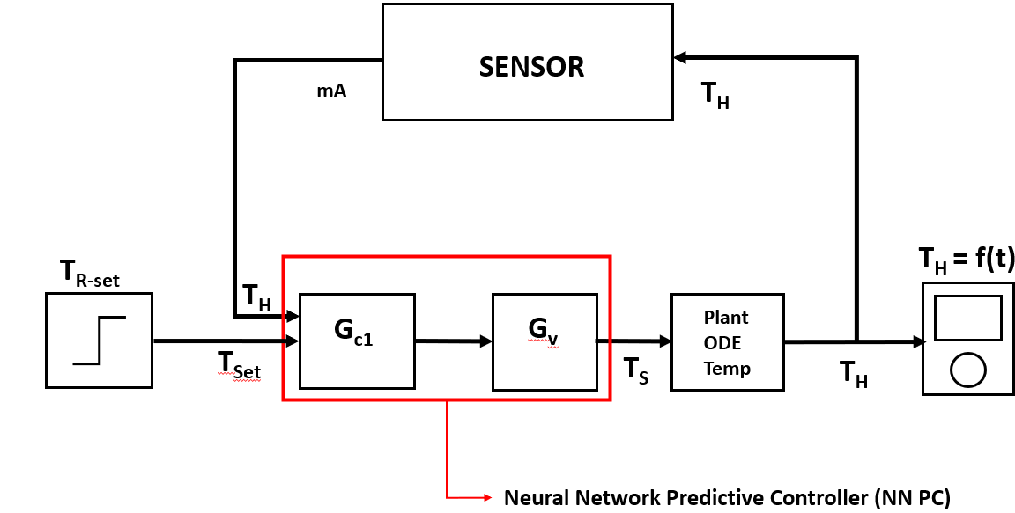
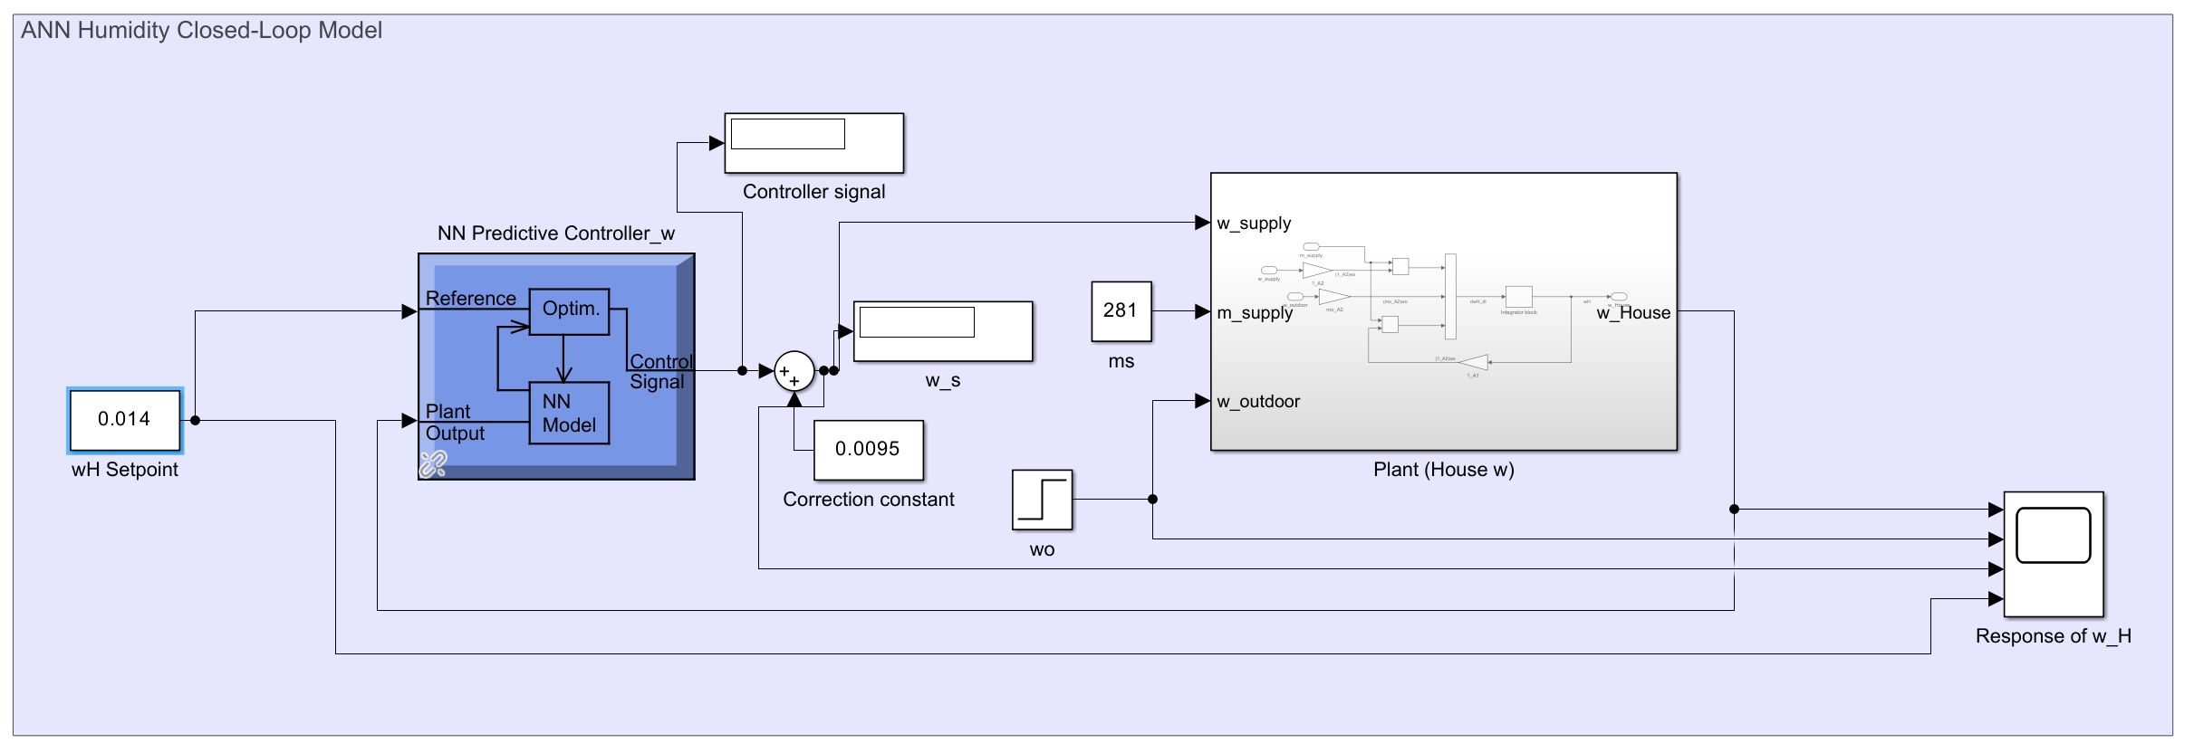
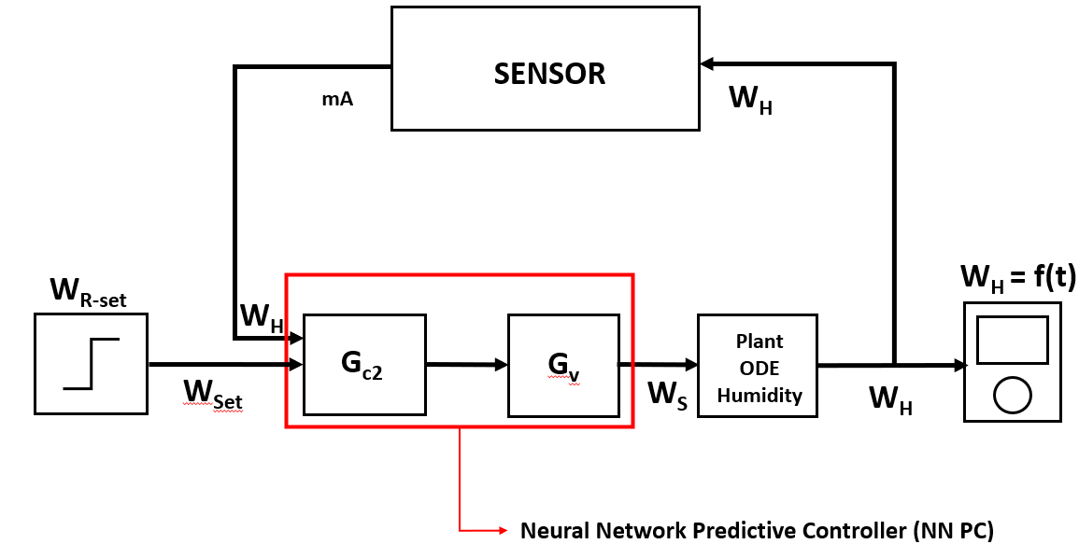
Methodology – Closed-Loop Block Diagram
Control System Block Diagram for Temperature
Fig 8. ANN Closed-Loop Simulink Model for T_{H}
Control System Block Diagram for Humidity
Fig 9. ANN Closed-Loop Simulink Model for T_{H}

Slide 10
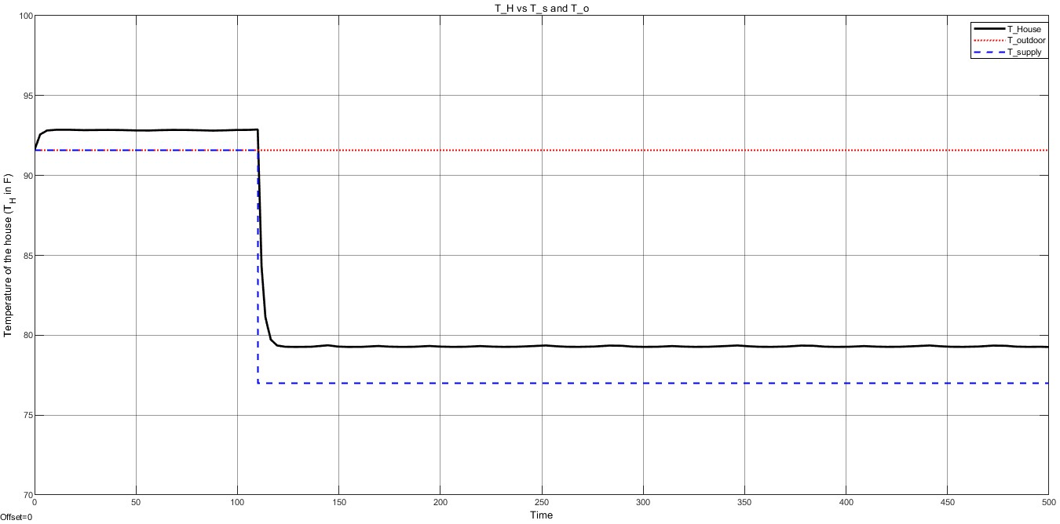
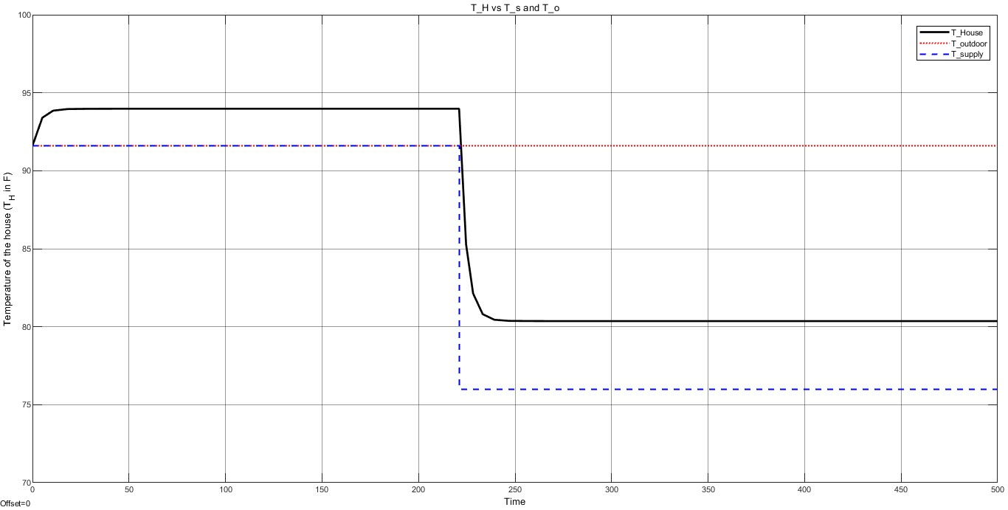
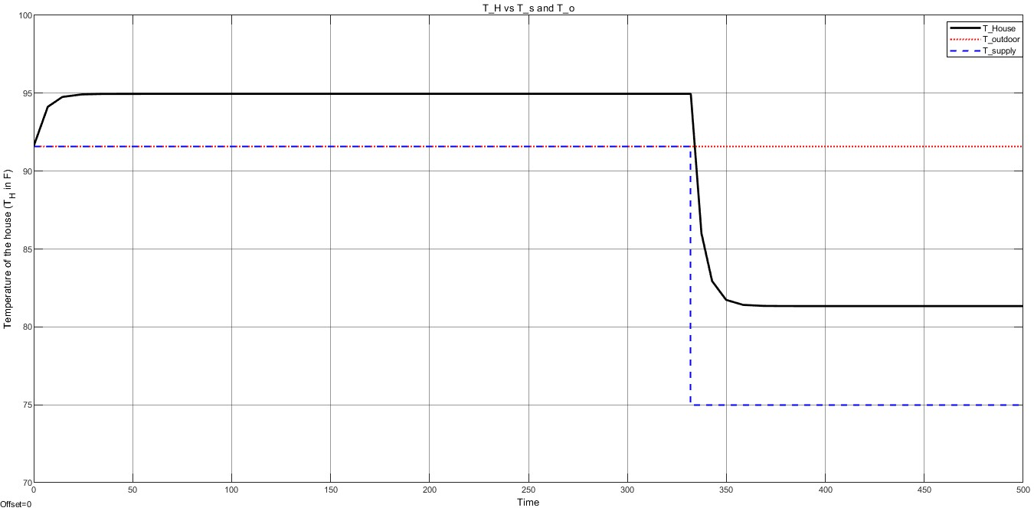
Results and Discussion – Open-Loop Model T_{H} Responses
T_{H} responses for setpoint changes in T_{S}
(B) Increased Ts
(A) Base Line
Fig 10. Open-Loop Model Response to T_{s} changes (A) Base Model (From Annual conditions data) (B) Increased T_{s} (C) Decreased Ts
(C) Decreased Ts

Slide 11
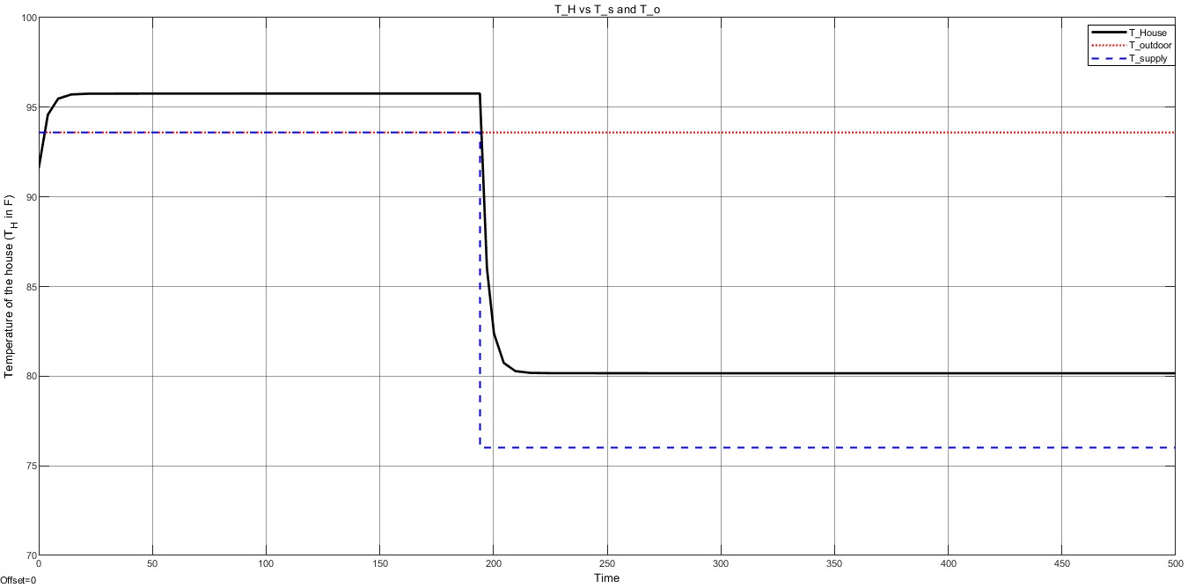
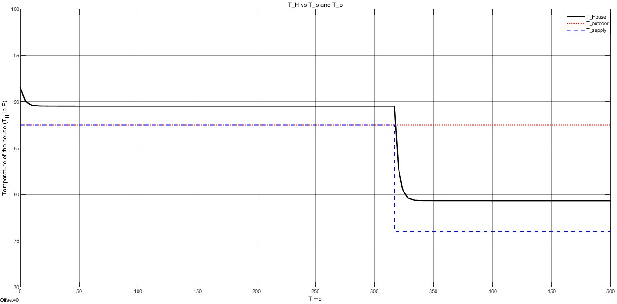
Results and Discussion – Open-Loop Model T_{H} Responses (CONT’D)
T_{H} responses for disturbance changes
(B) Increased To
(A) Base Line
Fig 11. Open-Loop Model Response to T_{o} changes (A) Base Model (From Annual conditions data) (B) Increased T_{o} (C) Decreased T_{o}
(C) Decreased To

Slide 12
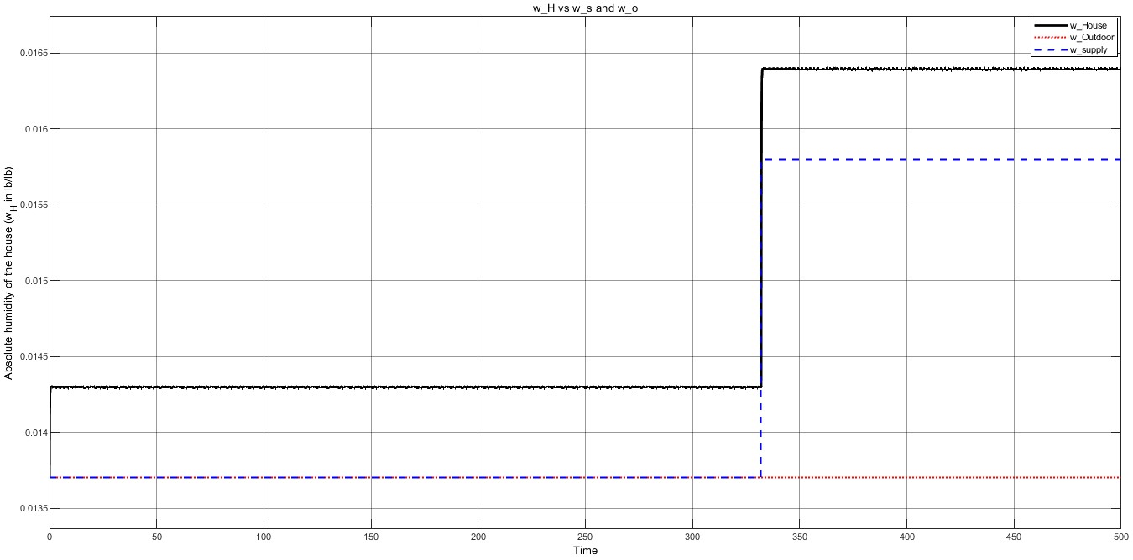
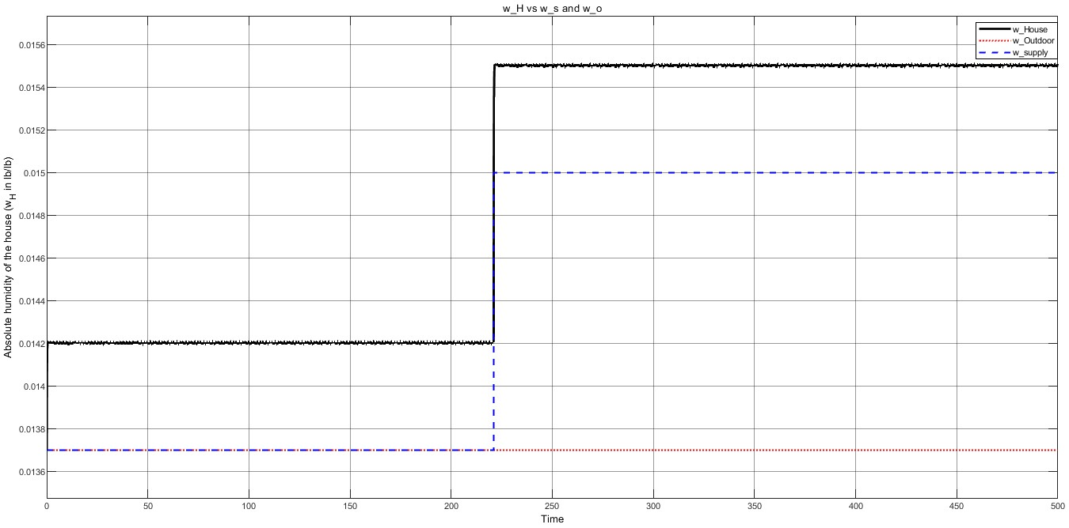
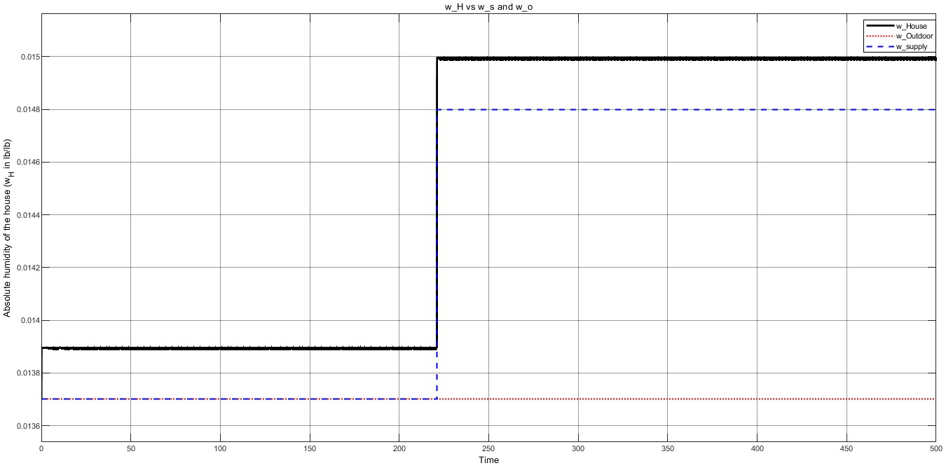
Results and Discussion – Open-Loop Model W_{H} Responses
W_{H} responses for setpoint changes in W_{S}
(B) Increased W_{s}
(A) Base Line
Fig 12. Open-Loop Model Response to W_{s} changes (A) Base Model (From Annual conditions data) (B) Increased W_{s} (C) Decreased W_{s}
(C) Decreased W_{s}

Slide 13
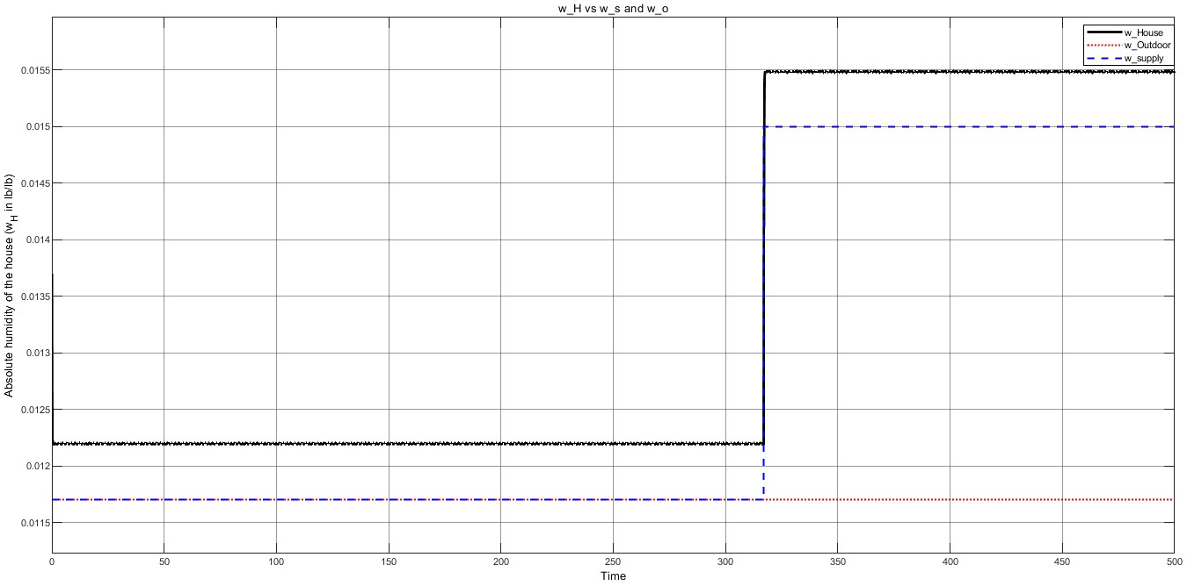
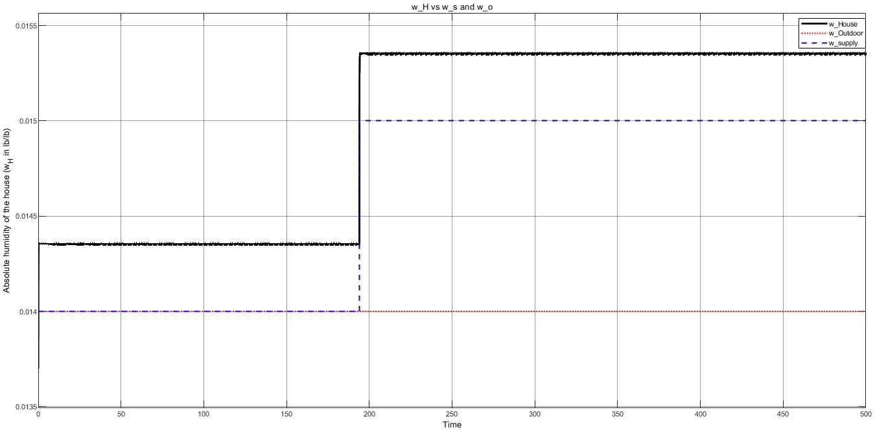
Results and Discussion – Open-Loop Model W_{H} Responses (CONT’D)
W_{H} responses for disturbance changes
(B) Increased W_{o}
(A) Base Line
Fig 13. Open-Loop Model Response to W_{o} changes (A) Base Model (From Annual conditions data) (B) Increased W_{o} (C) Decreased W_{o}
(C) Decreased W_{o}

Slide 14
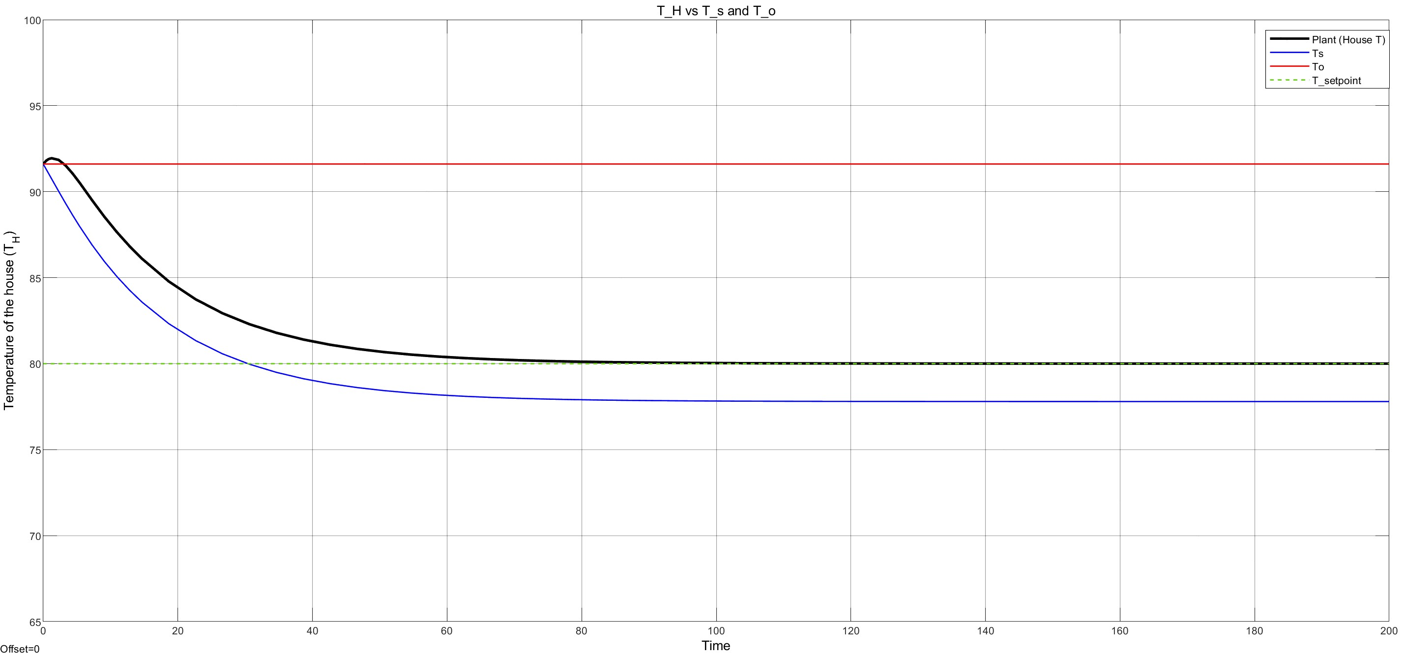
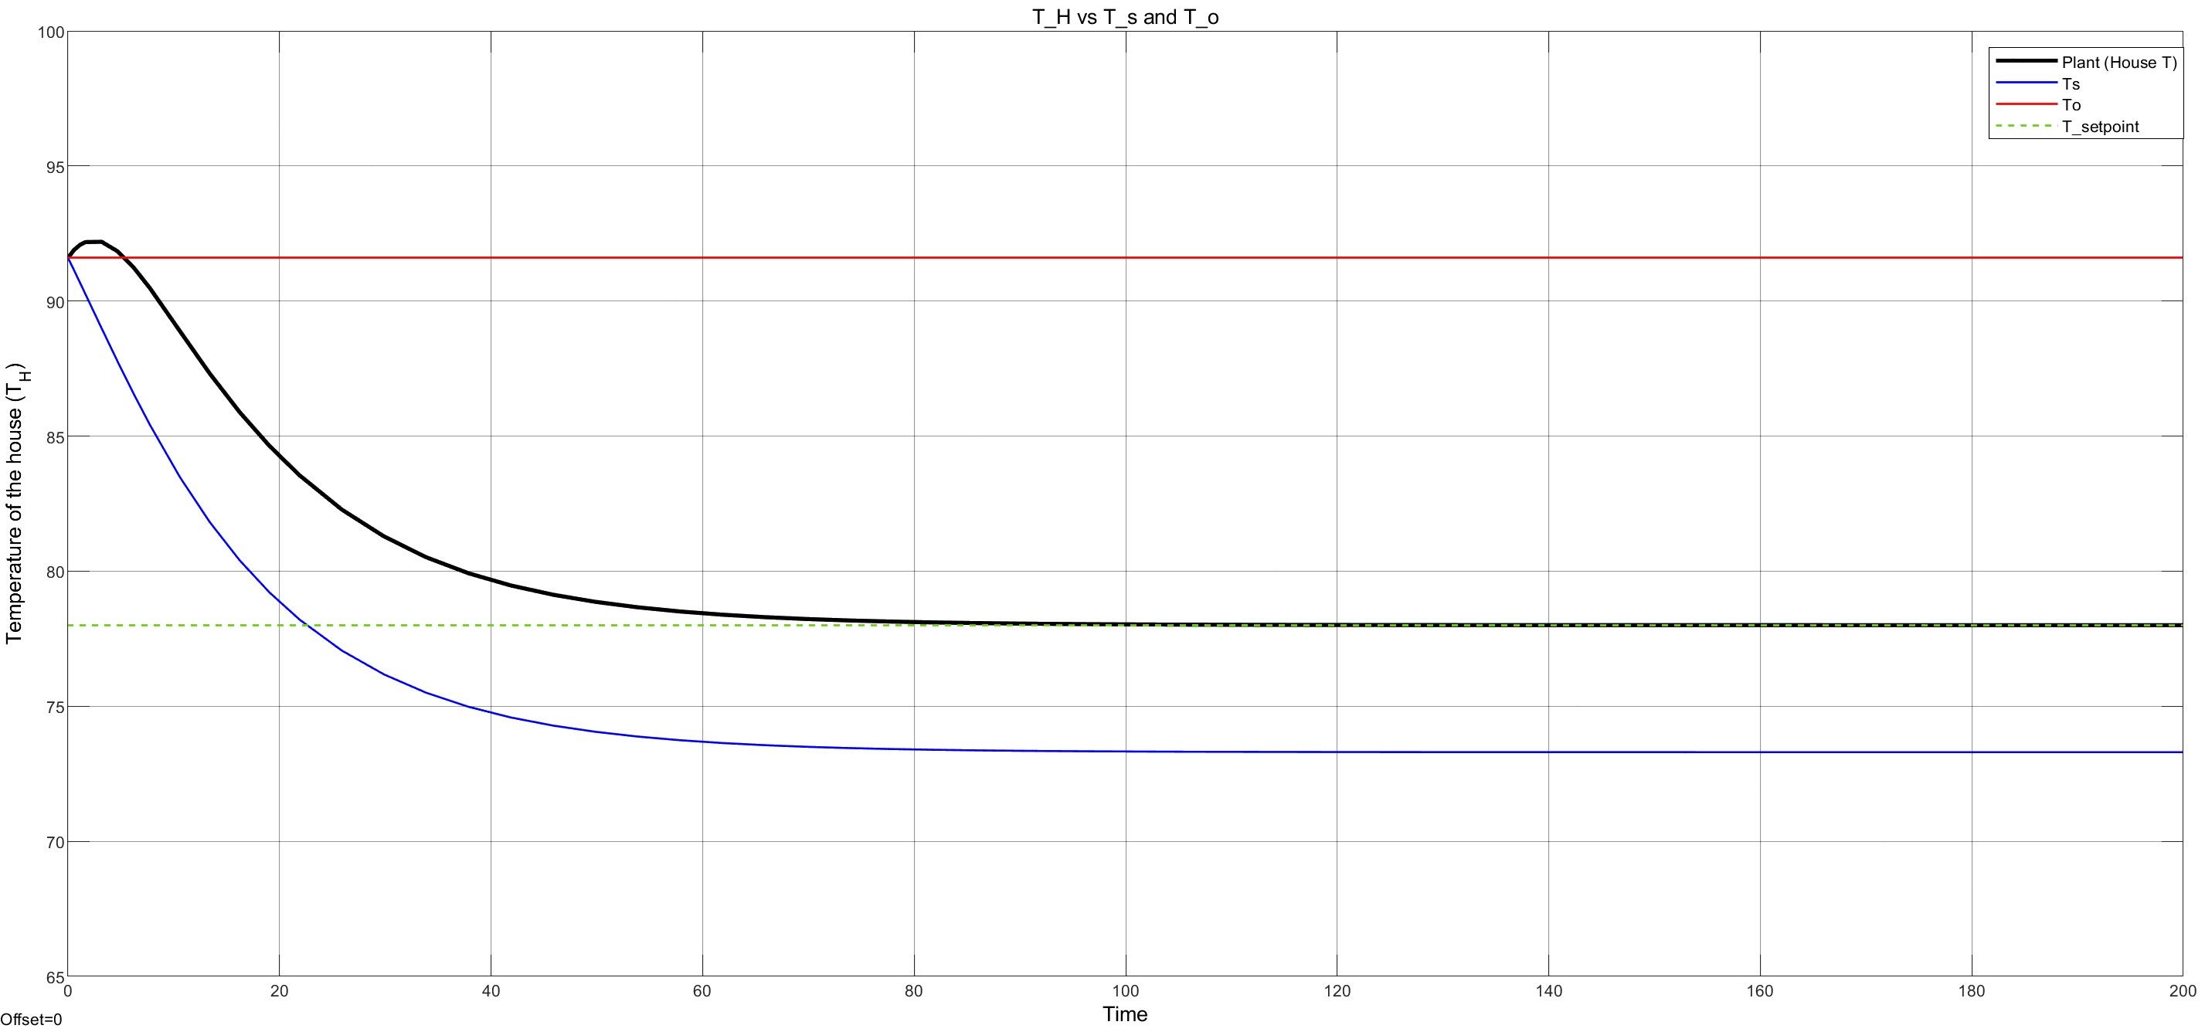
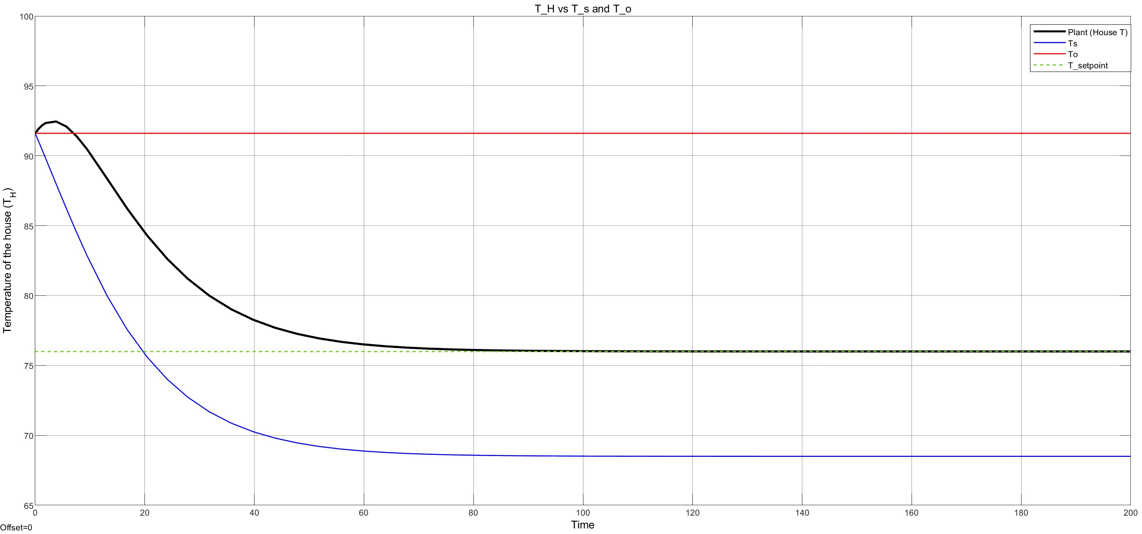
Results and Discussion – Closed-Loop PID Model T_{H} Responses
T_{H} responses for setpoint and disturbance changes
(B) Increased T_{set}
(A) Base Line
Fig 14. Closed-Loop Model Response to T_{set} changes (A) Base Model (From Annual conditions data) (B) Increased T_{set} (C) Decreased T_{set}
(C) Decreased T_{set}

Slide 15
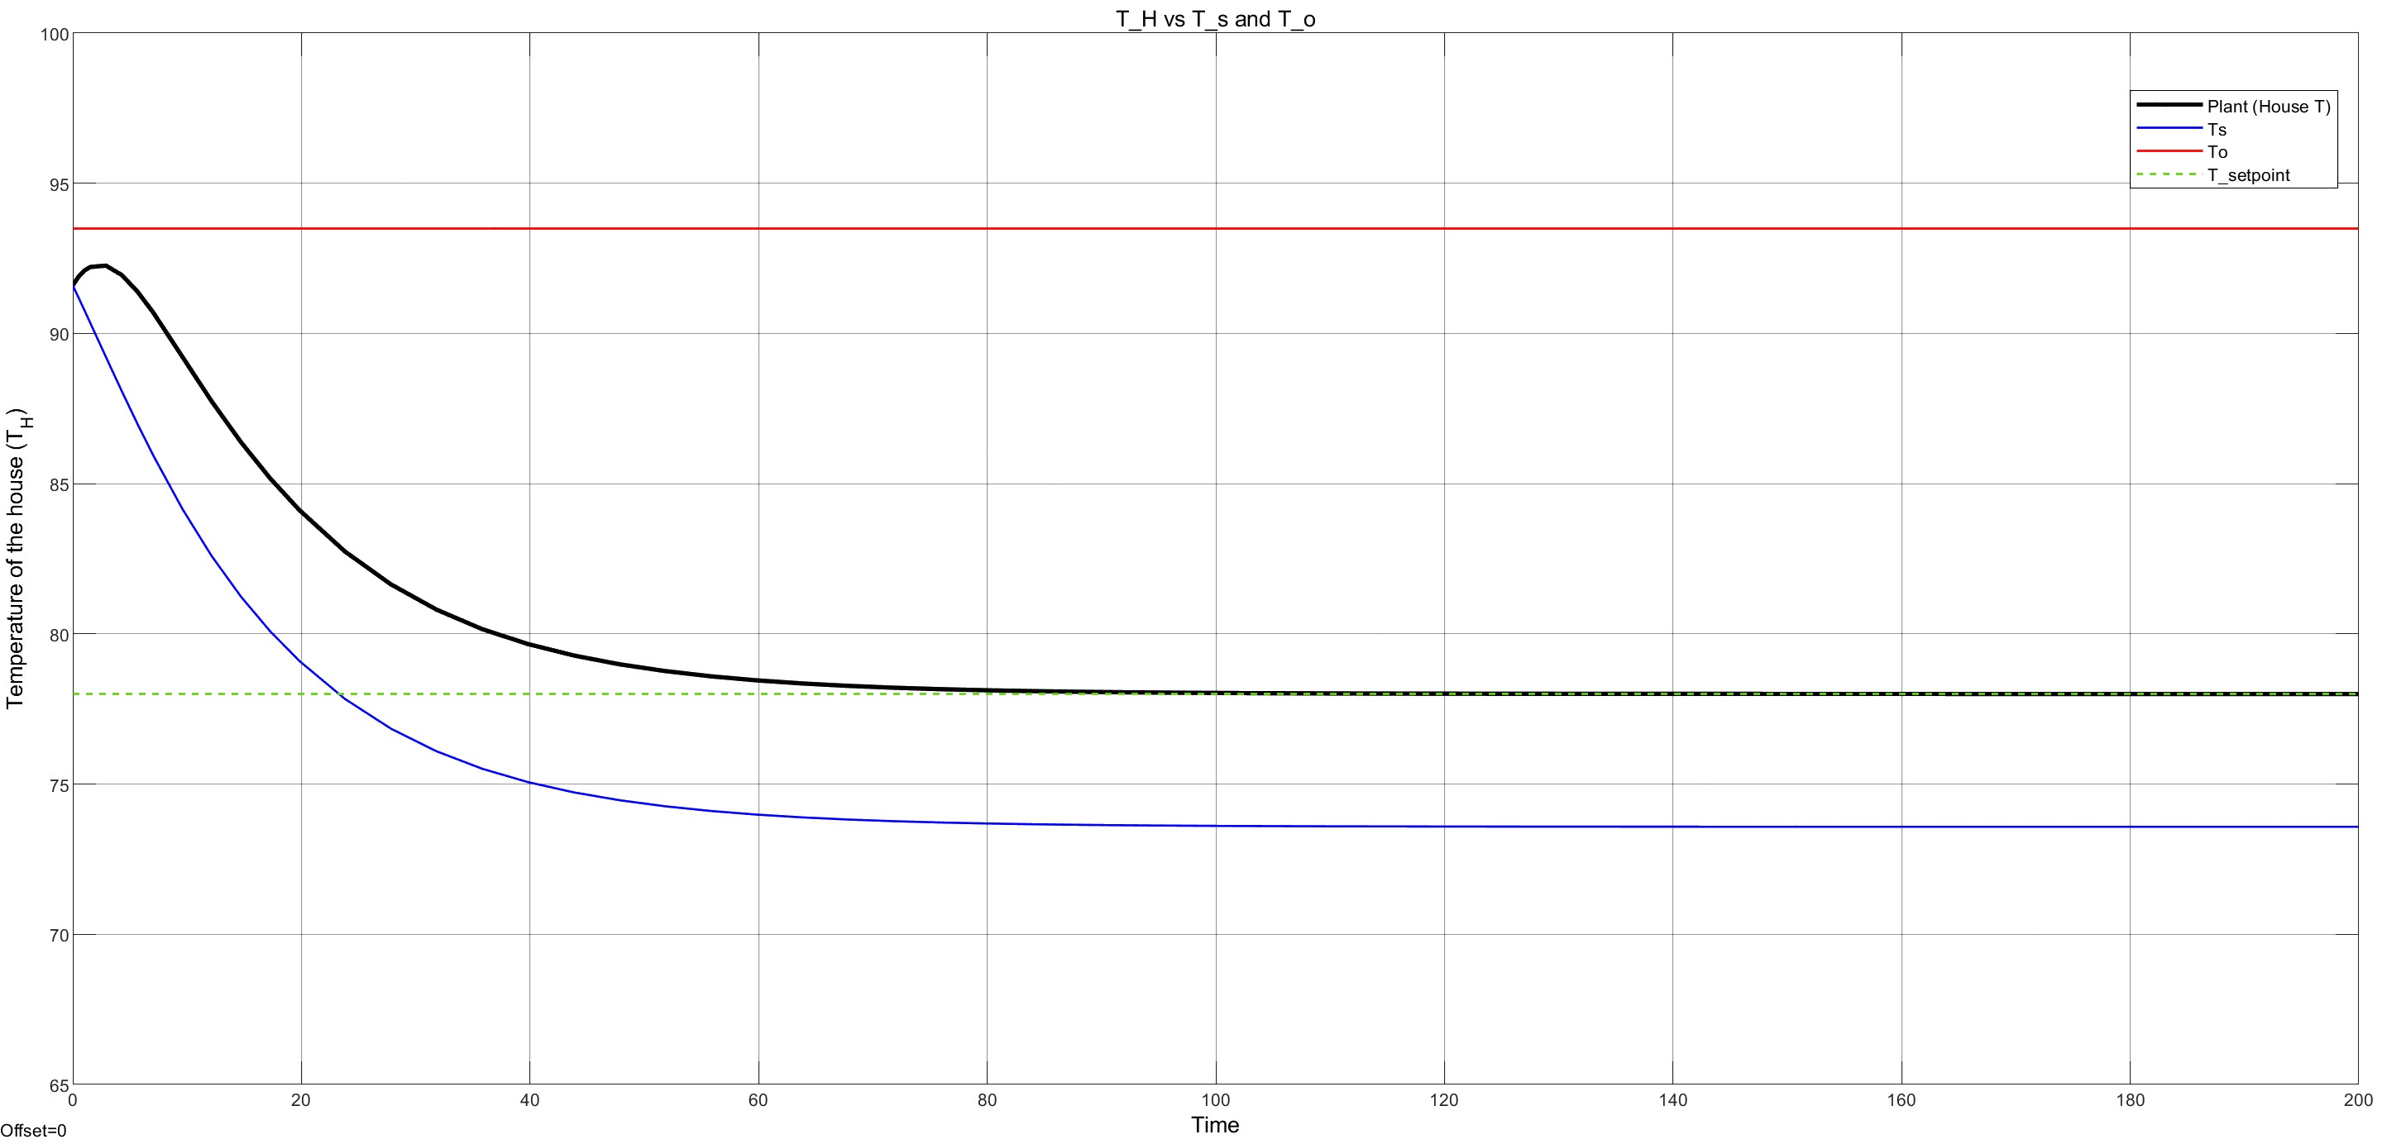
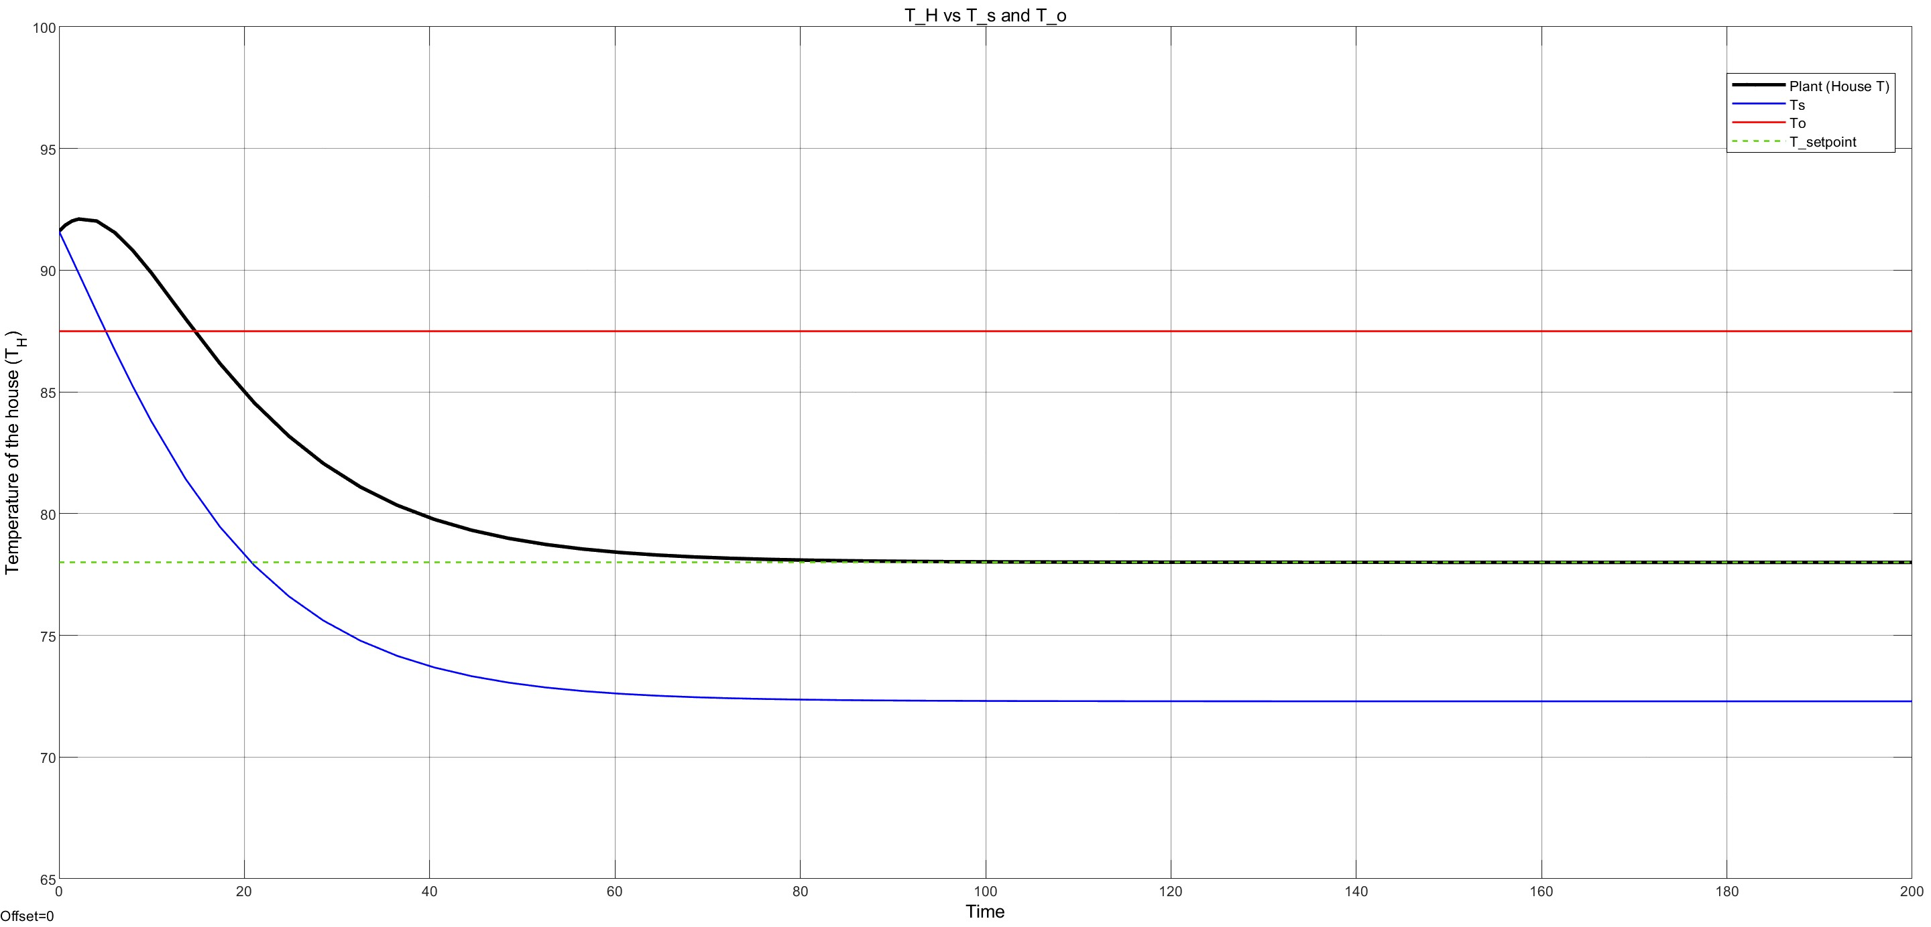
Results and Discussion – Closed-Loop PID Model T_{H} Responses (CONT’D)
T_{H} responses for setpoint and disturbance changes
(B) Increased T_{O}
(A) Base Line
Fig 15. Closed-Loop Model Response to T_{o} changes (A) Base Model (From Annual conditions data) (B) Increased T_{o} (C) Decreased T_{o}
(C) Decreased T_{O}

Slide 16
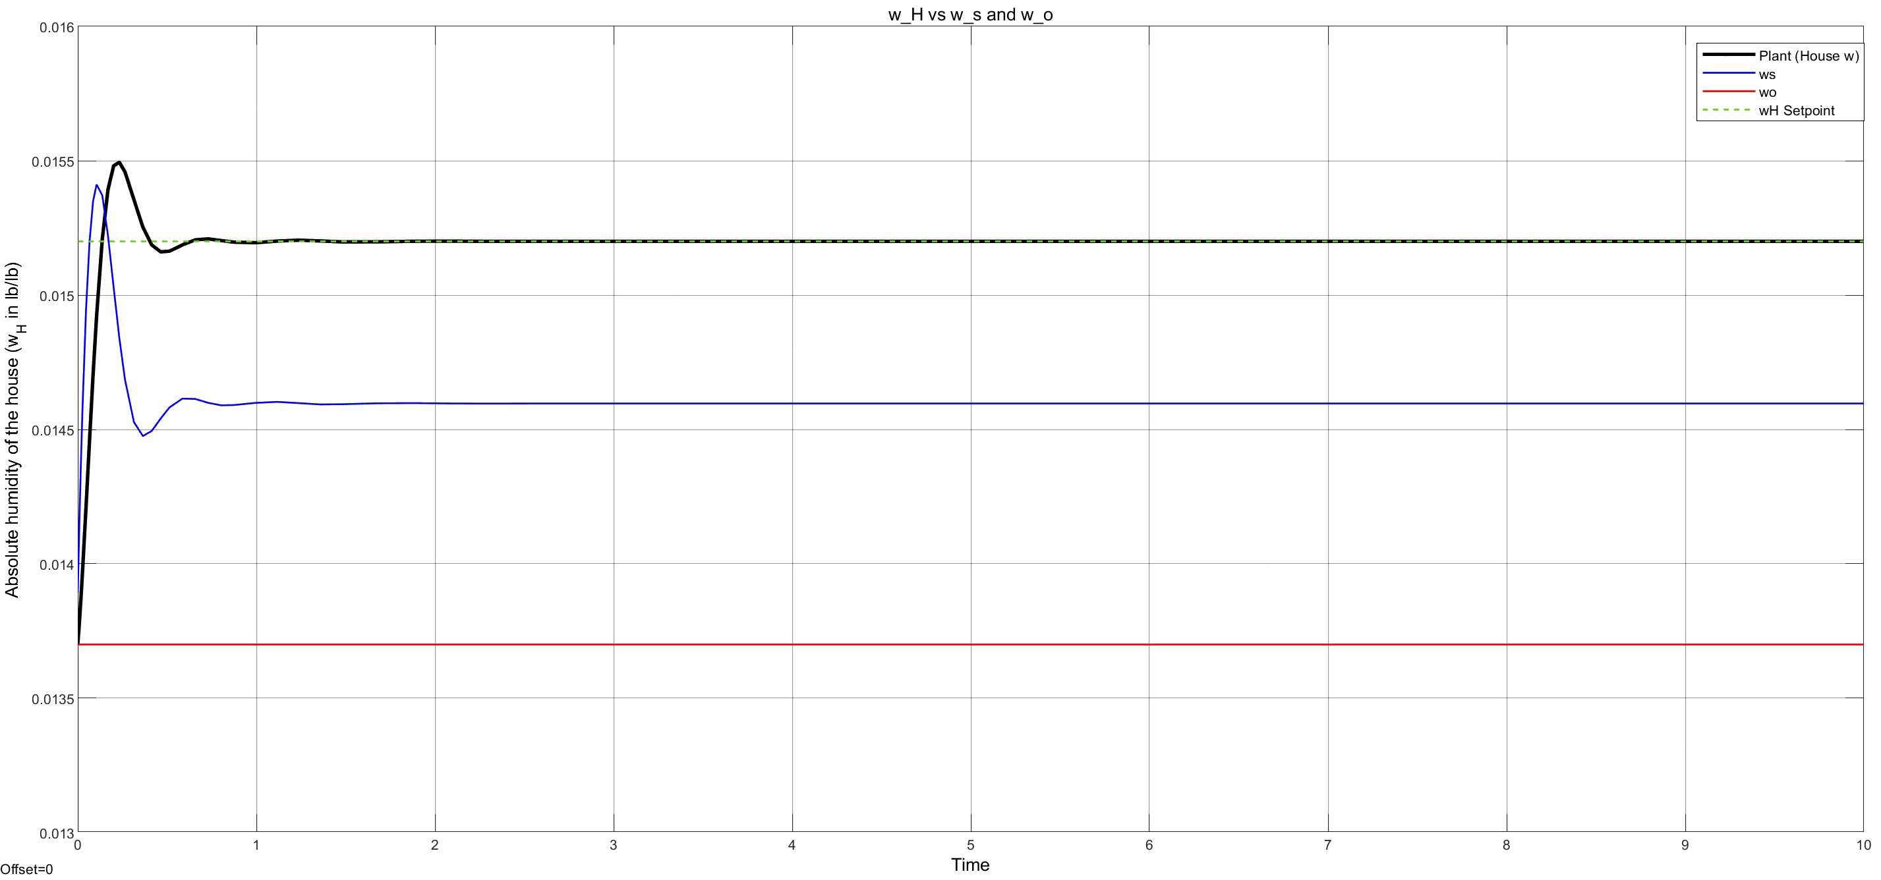
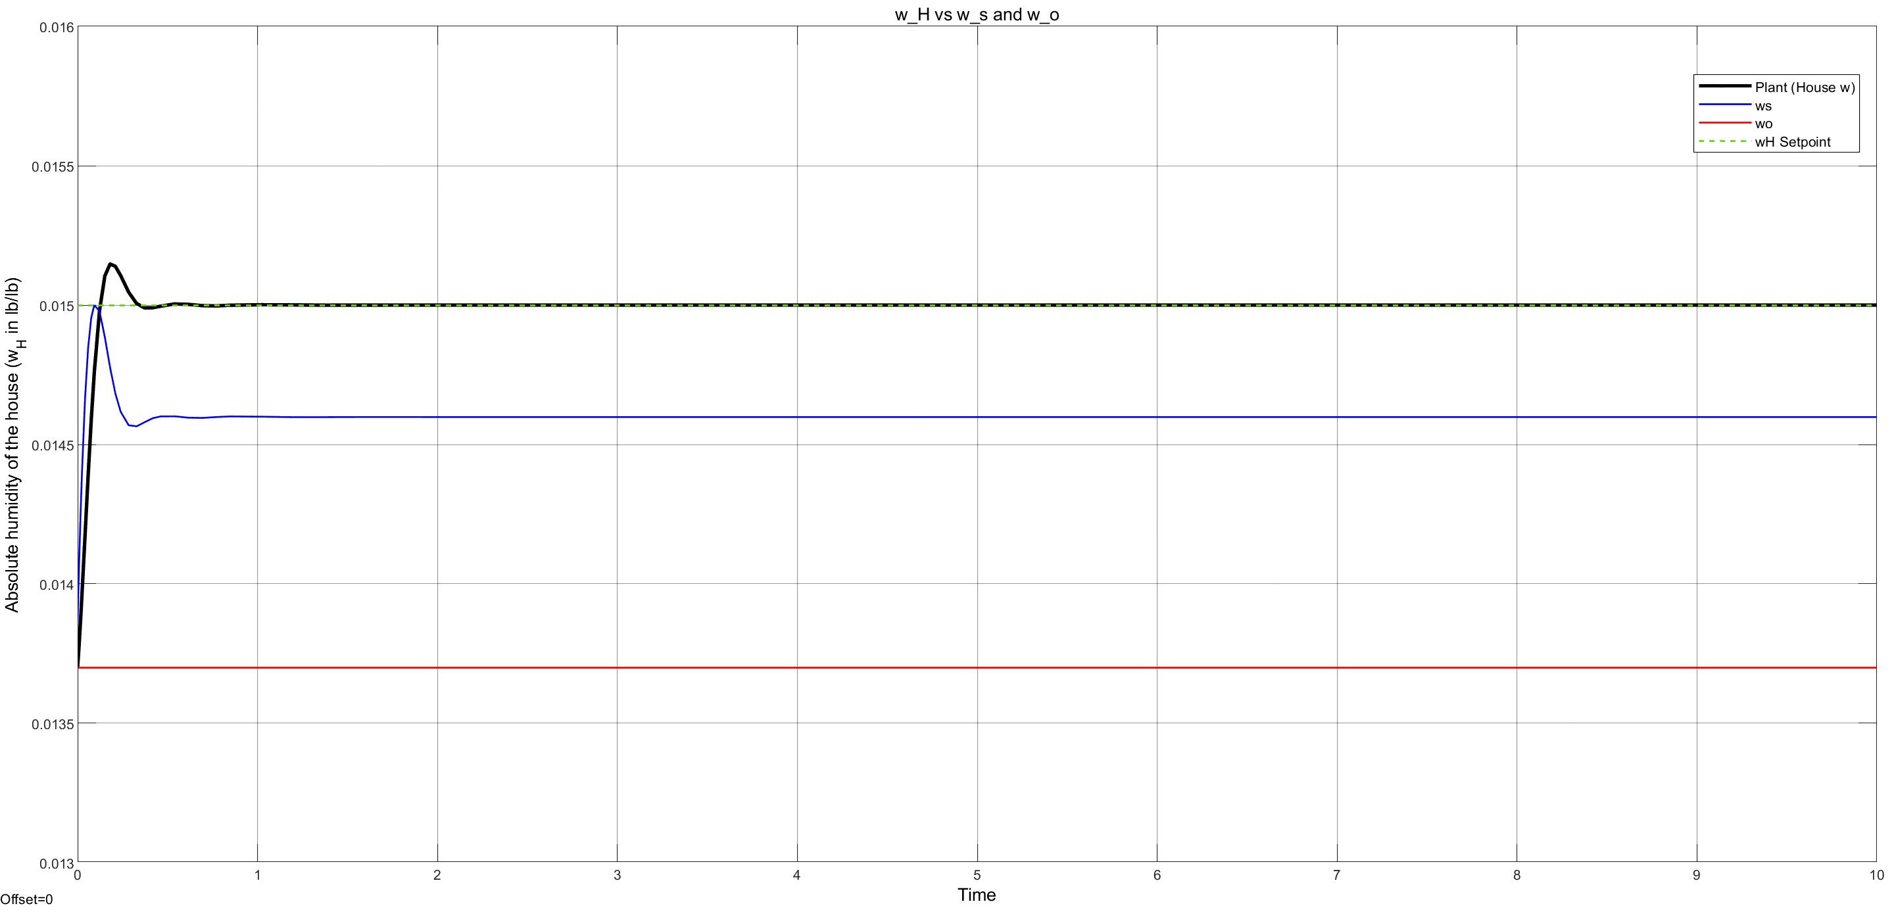
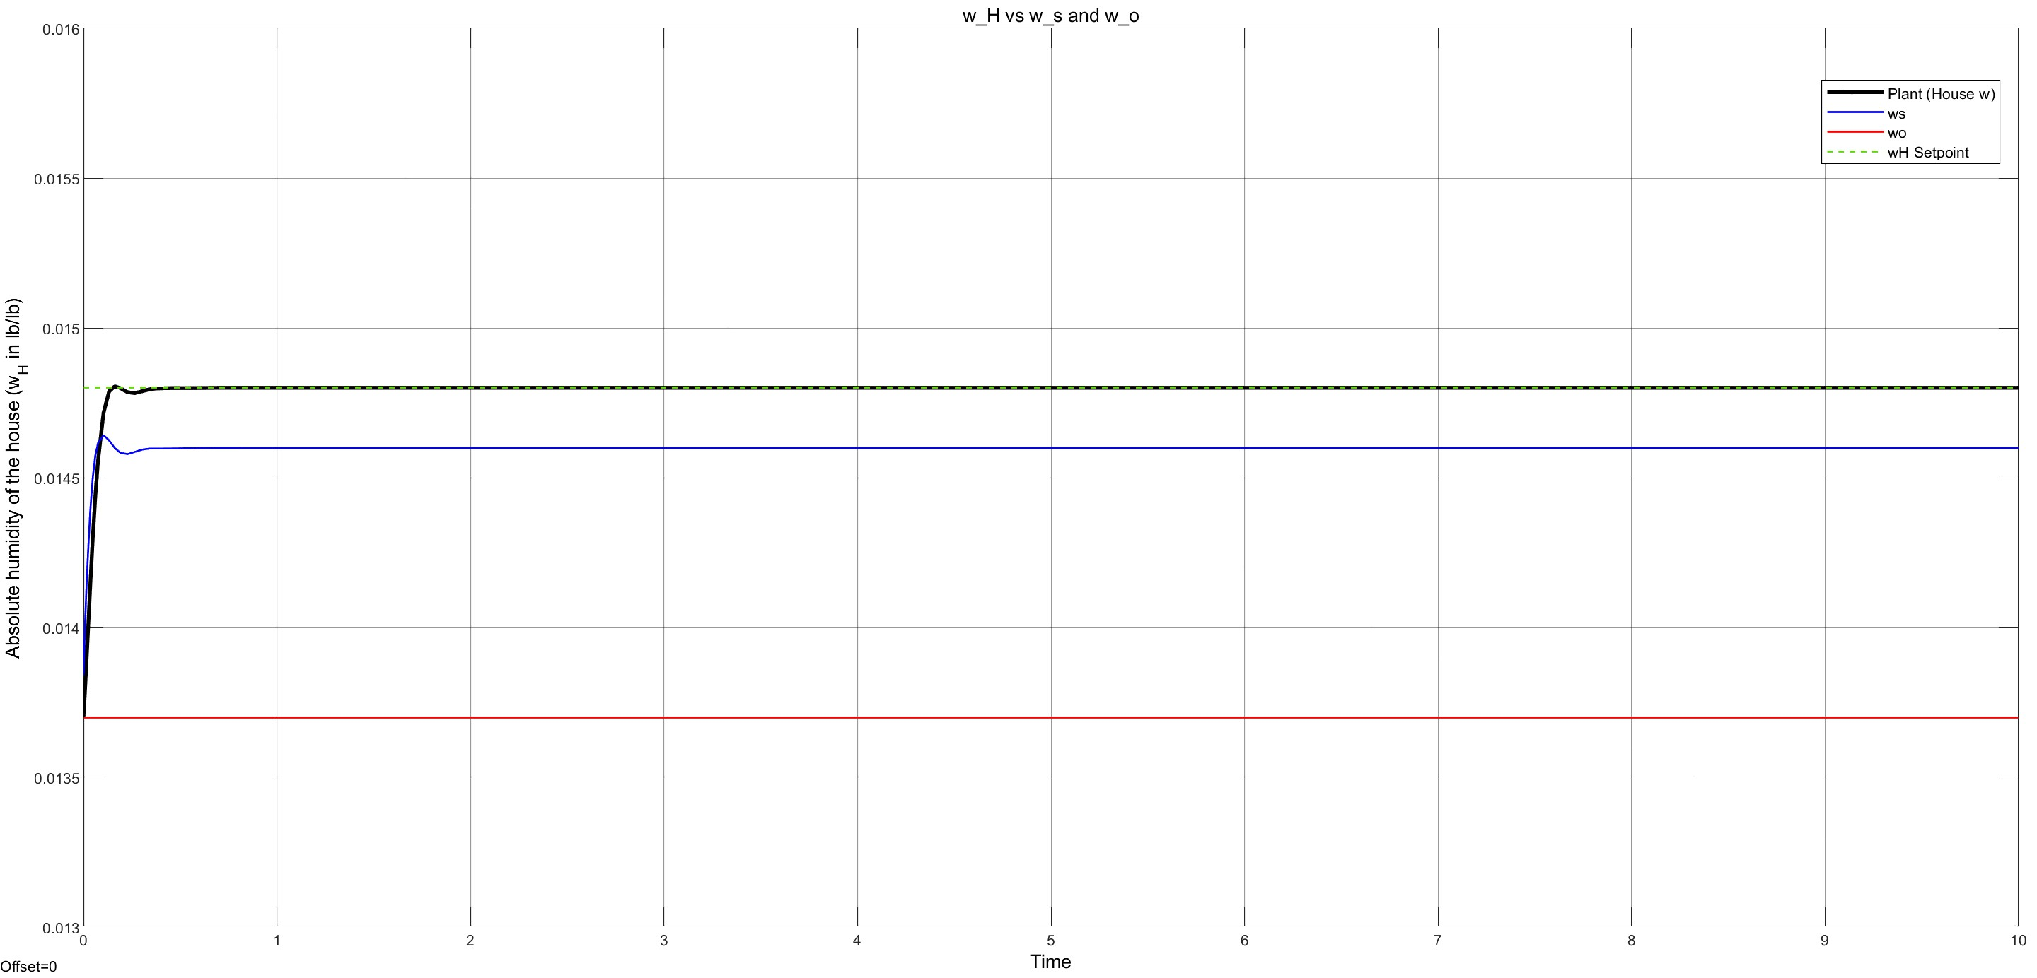
Results and Discussion – Closed-Loop PID Model W_{H} Responses
W_{H} responses for setpoint and disturbance changes
(B) Increased W_{set}
(A) Base Line
Fig 16. Open-Loop Model Response to W_{set} changes (A) Base Model (From Annual conditions data) (B) Increased W_{set} (C) Decreased W_{set}
(C) Decreased W_{set}

Slide 17
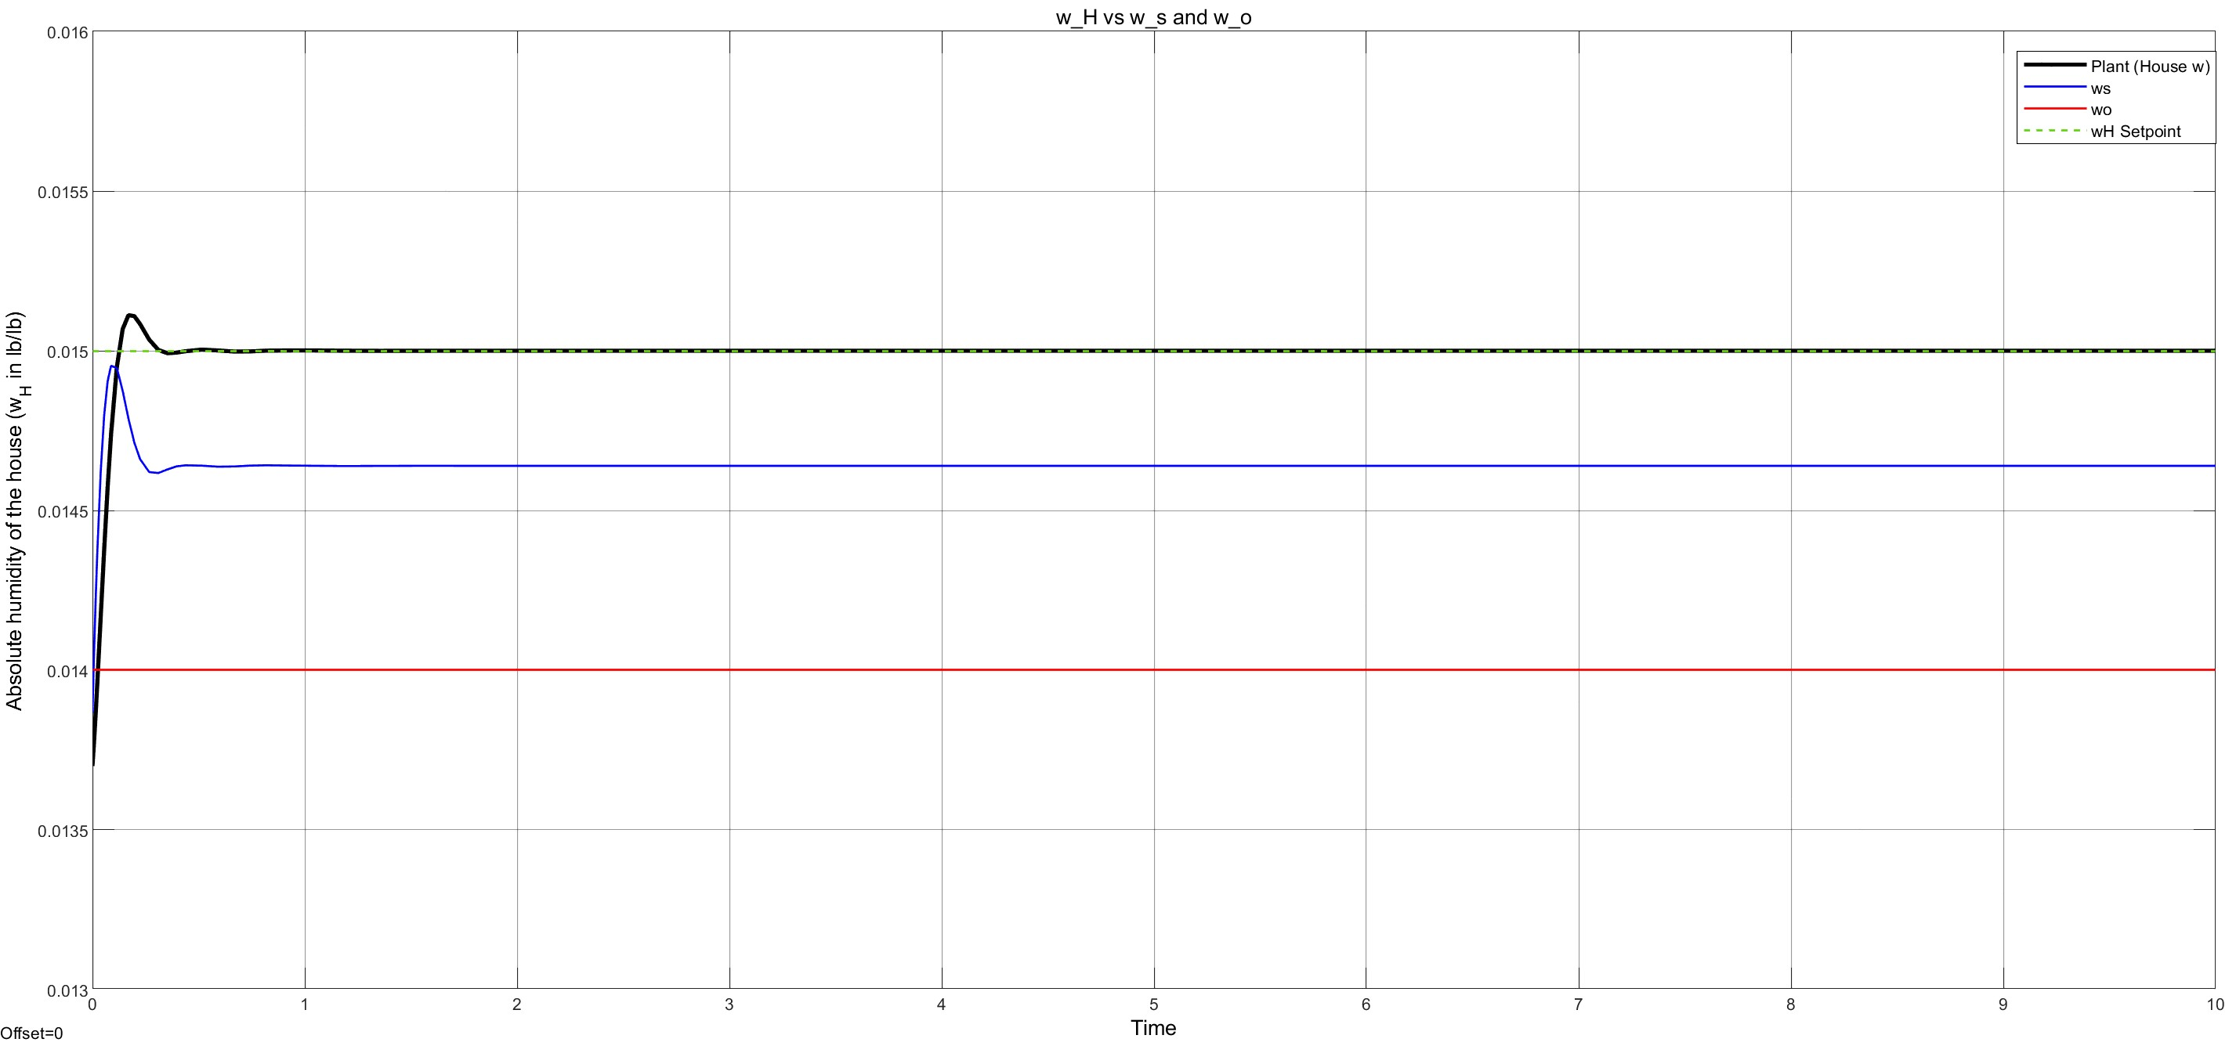
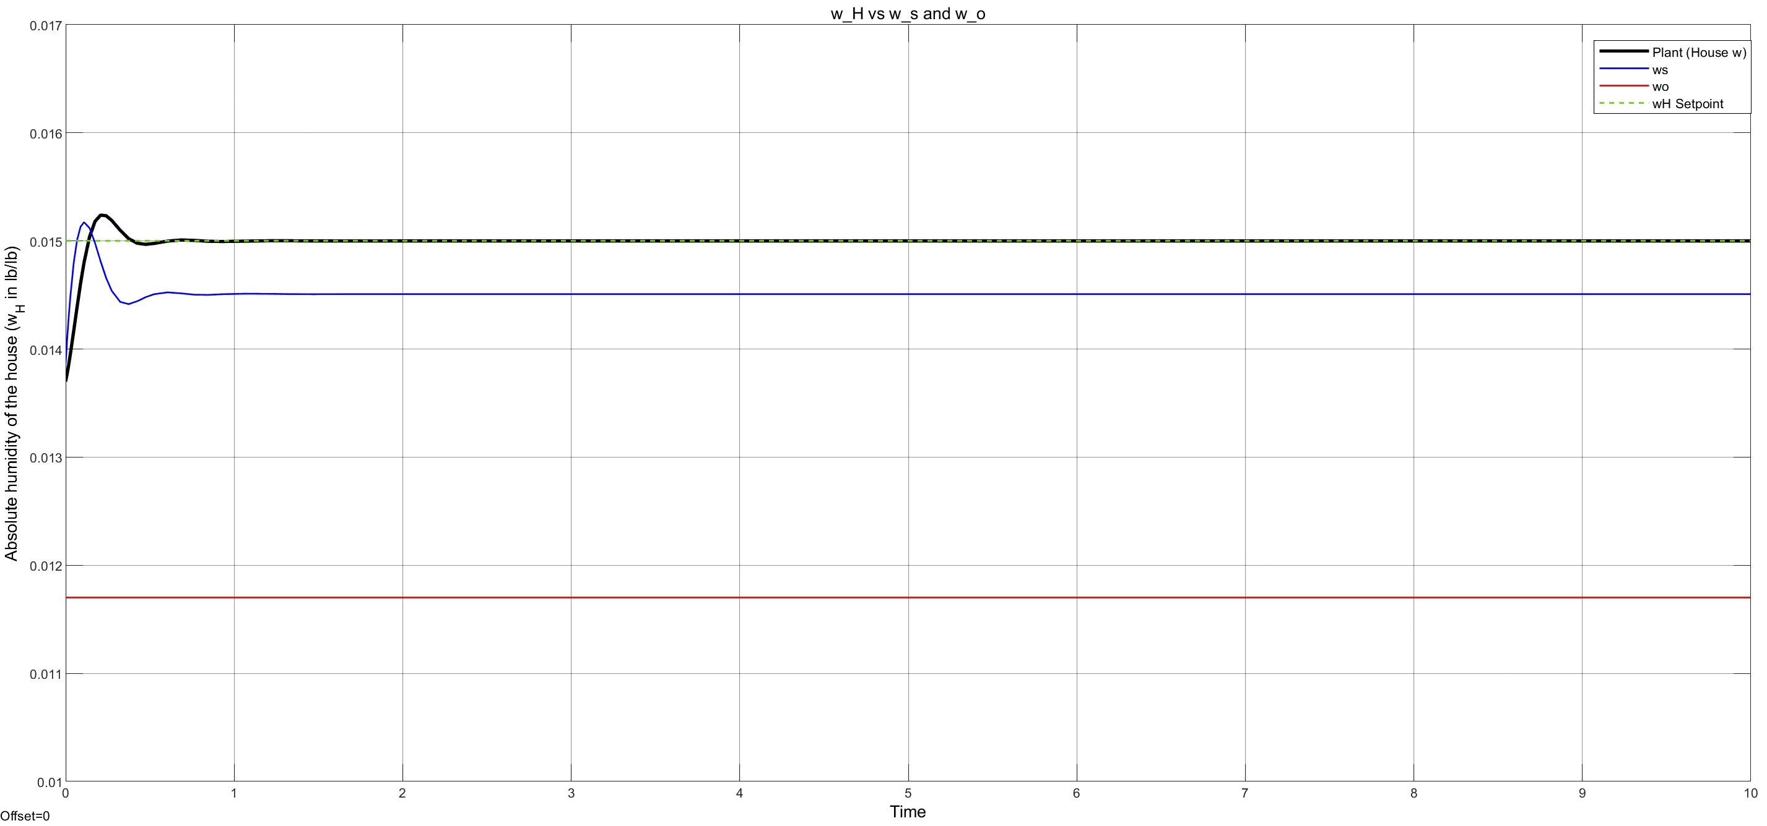
Results and Discussion – Closed-Loop PID Model W_{H} Responses (CONT’D)
W_{H} responses for setpoint and disturbance changes
(B) Increased W_{O}
(A) Base Line
Fig 22. Closed-Loop Model Response to W_{o} changes (A) Base Model (From Annual conditions data) (B) Increased W_{o} (C) Decreased W_{o}
(C) Decreased W_{O}

Slide 18
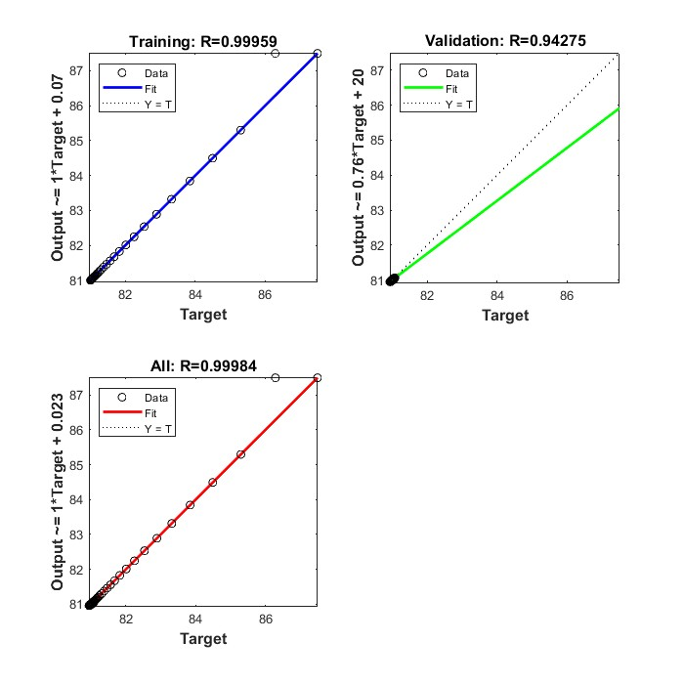
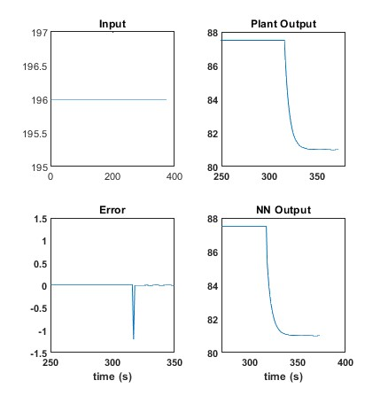
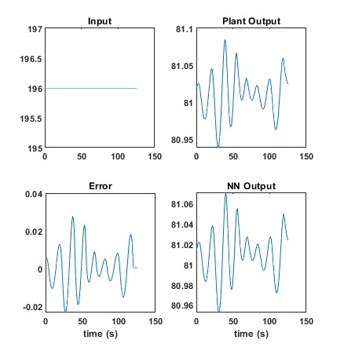
Results and Discussion – ANN Plots for Temperature
Training model for ANN 3X based on T setpoint and disturbance changes, as elaborated in previous slide
(A) Regression Plot (40 neurons)
(B) Response Plot (40 neurons)
(C) Validation Plot (40 neurons)
Fig 14. ANN plots for Temperature

Slide 19
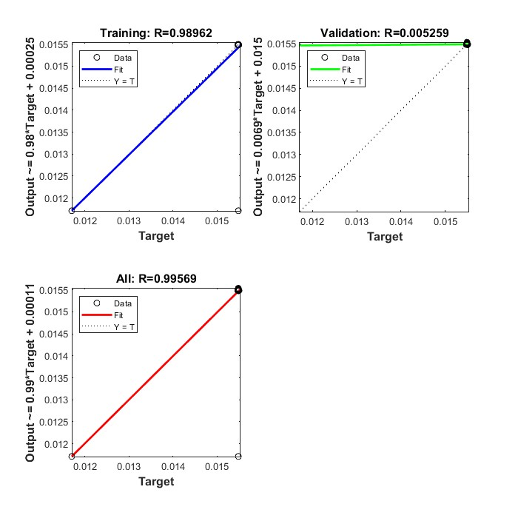
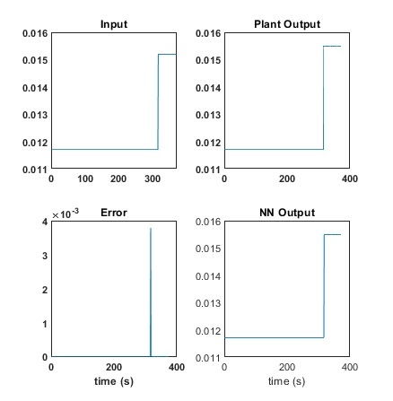
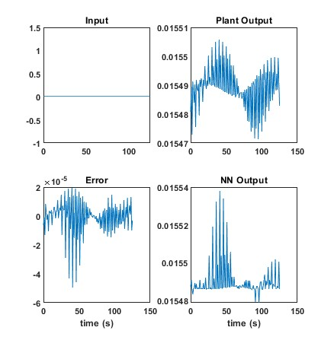
Results and Discussion – ANN Plots for Humidity
Training model for ANN 3X based on W setpoint and disturbance changes
(A) Regression plot (35 neurons)
(B) Response plot (35 neurons)
(C) Validation (35 neurons)
Fig 15. ANN plots for Humidity

Slide 20
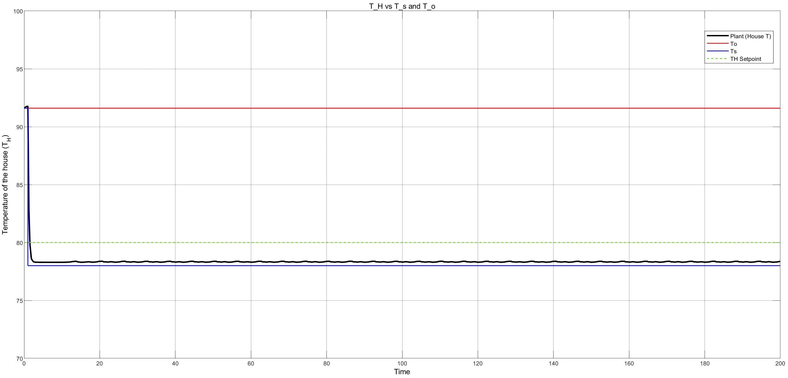
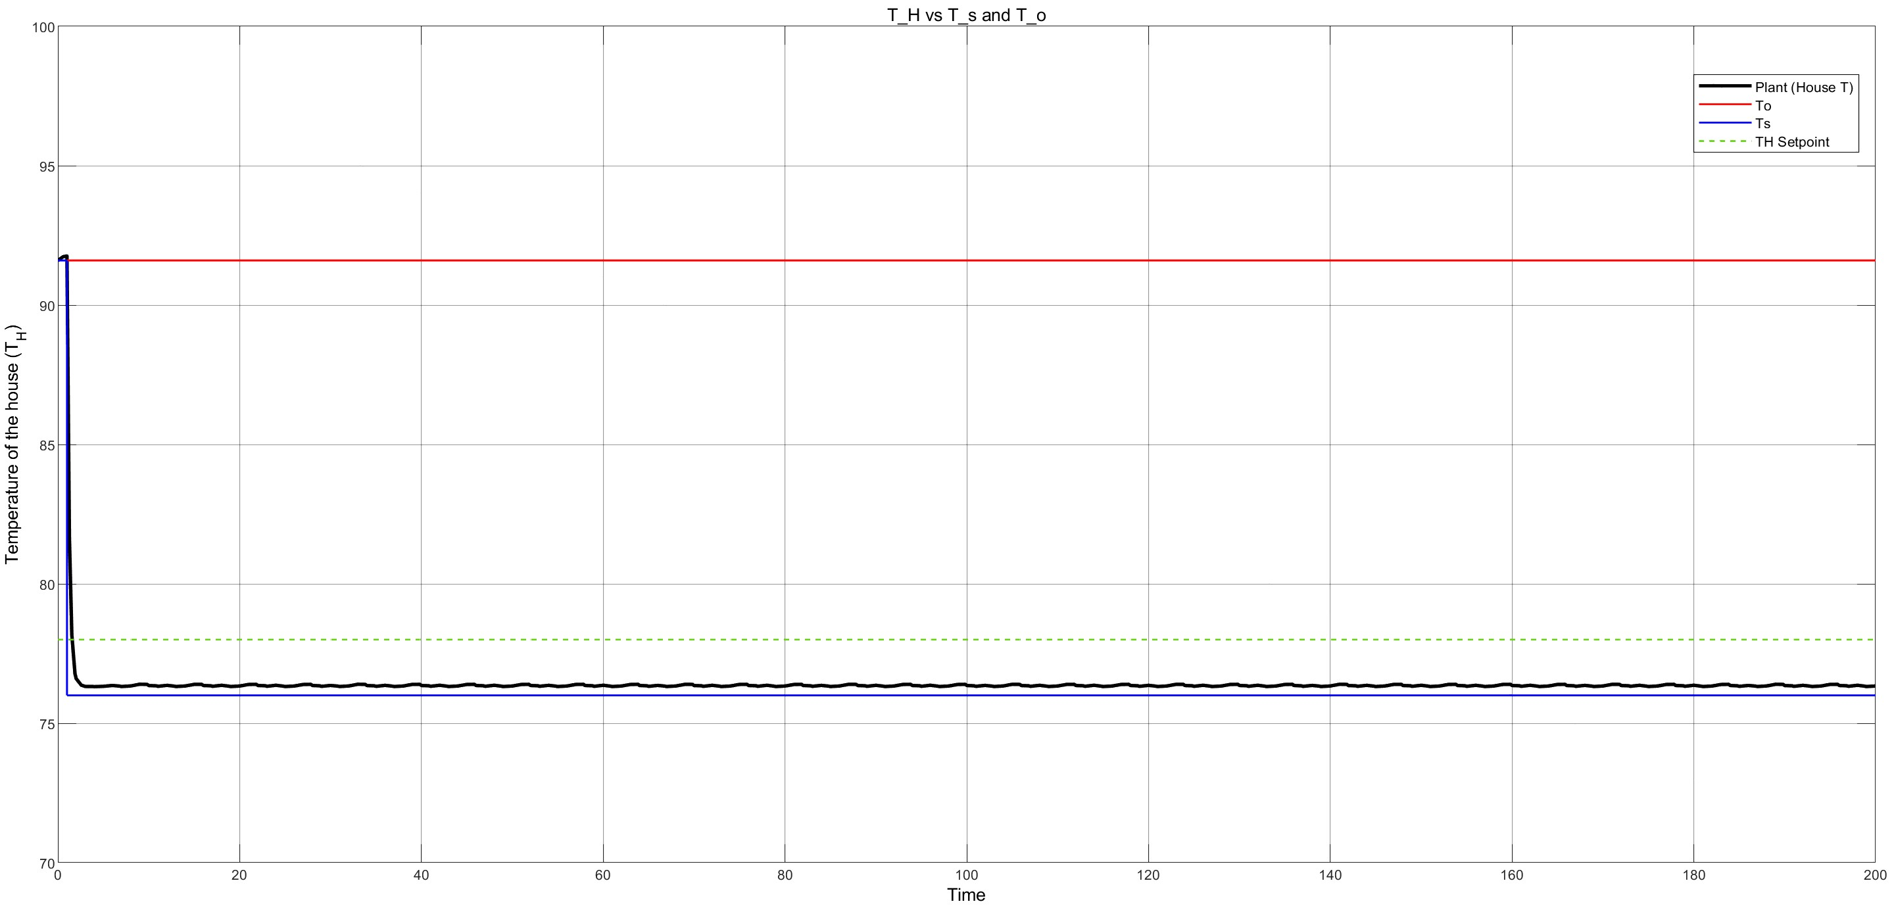
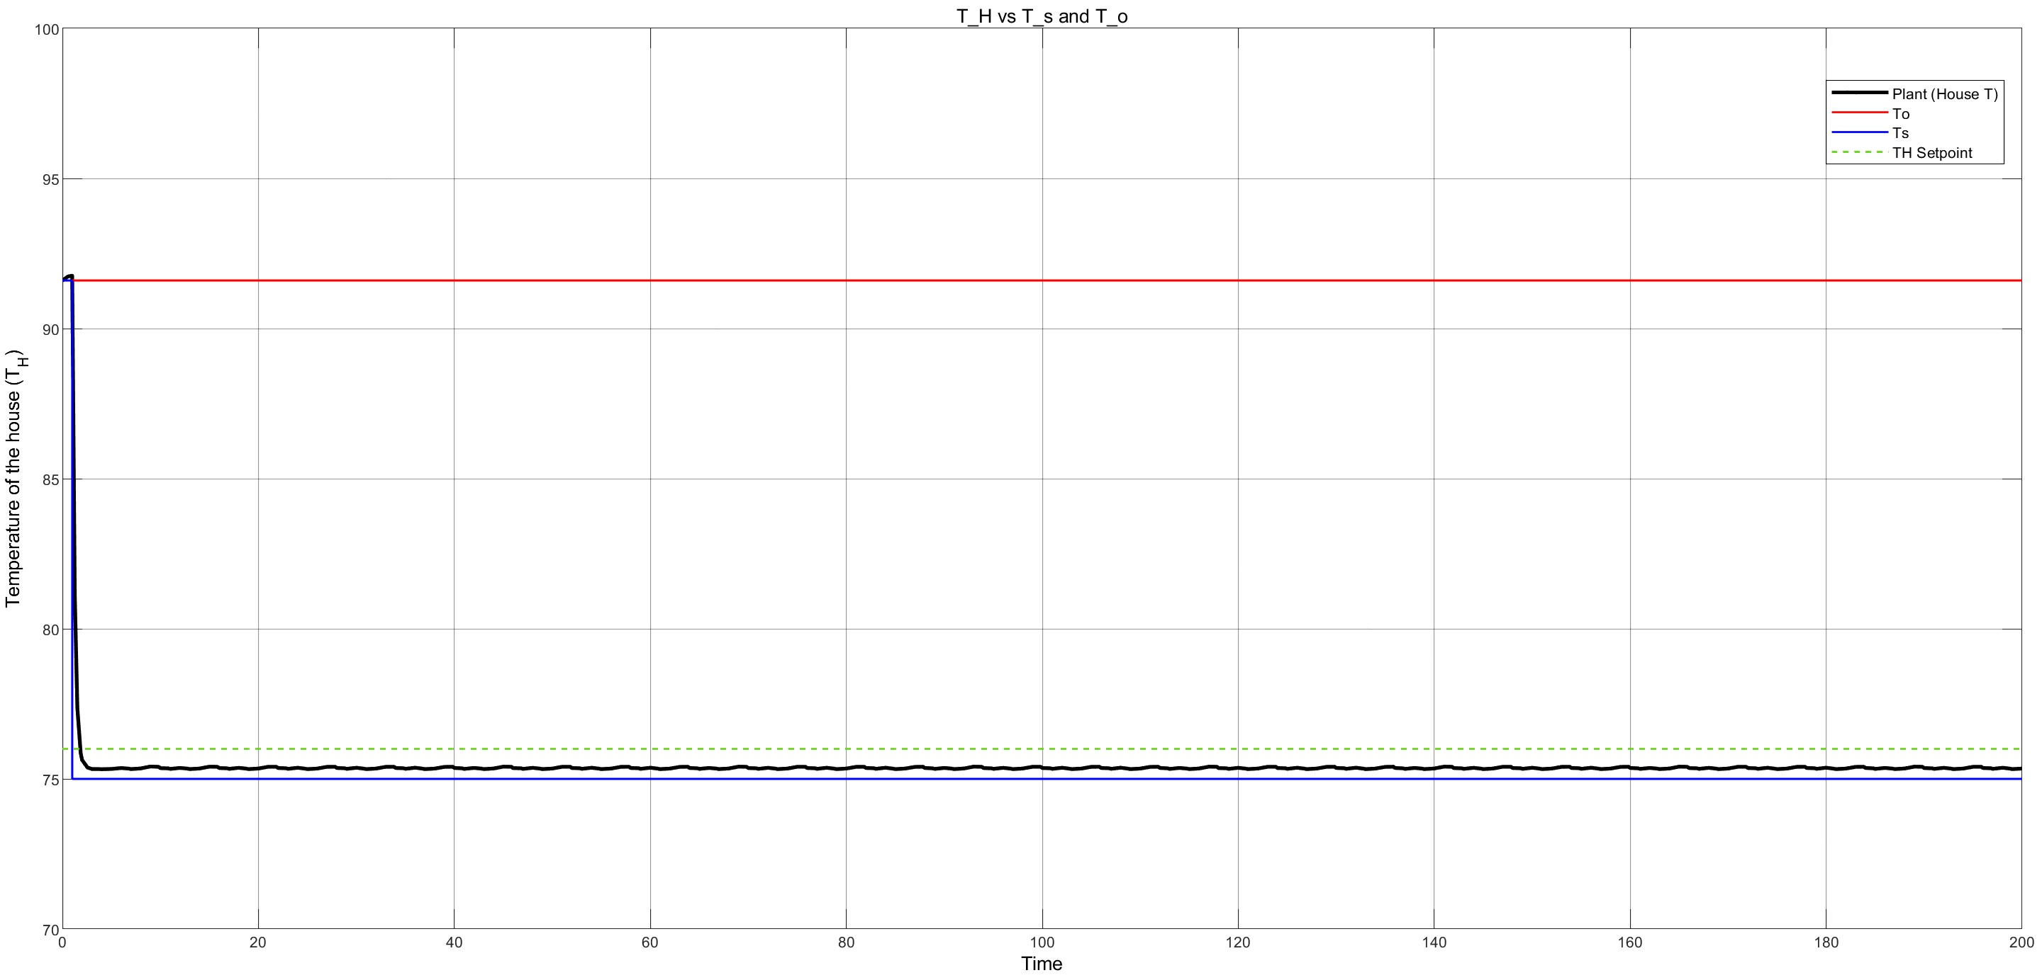
Results and Discussion – Closed-Loop Model T_{H} Responses
T_{H} responses for setpoint and disturbance changes
(B) Increased T_{set}
(A) Base Line
Fig 19. Closed-Loop Model Response to T_{set} changes (A) Base Model (From Annual conditions data) (B) Increased T_{set} (C) Decreased T_{set}
(C) Decreased T_{set}

Slide 21
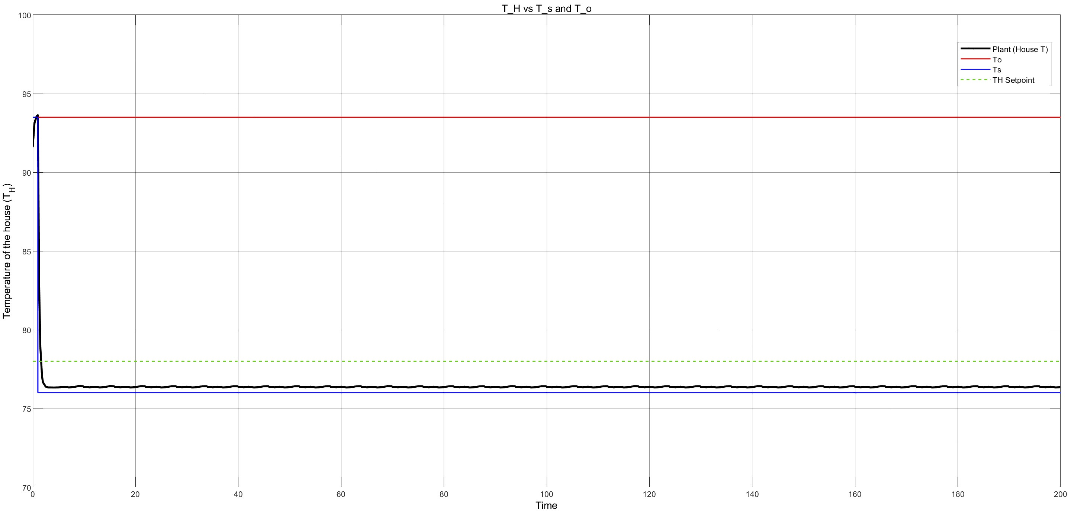
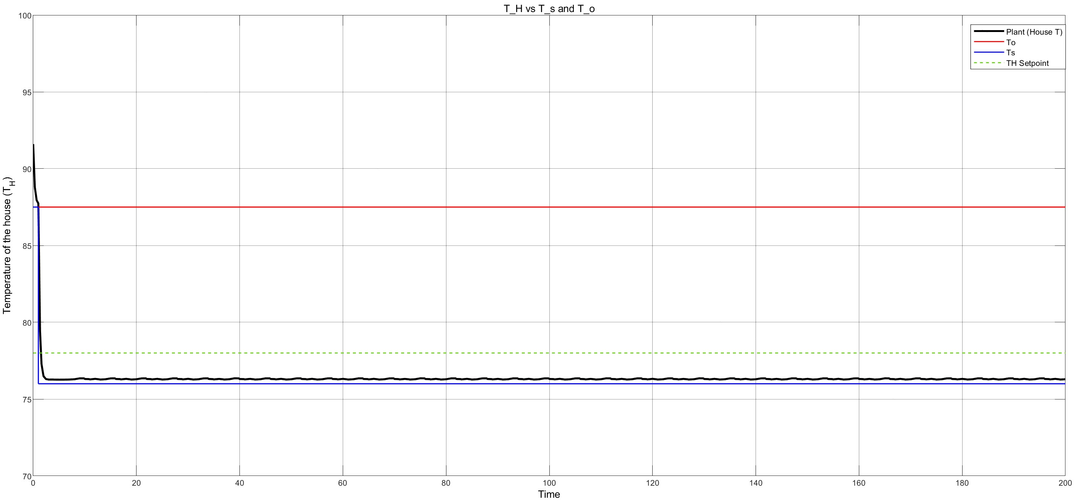
Results and Discussion – Closed-Loop Model T_{H} Responses (CONT’D)
T_{H} responses for setpoint and disturbance changes
(B) Increased T_{O}
(A) Base Line
Fig 20. Closed-Loop Model Response to T_{o} changes (A) Base Model (From Annual conditions data) (B) Increased T_{o} (C) Decreased T_{o}
(C) Decreased T_{O}

Slide 22
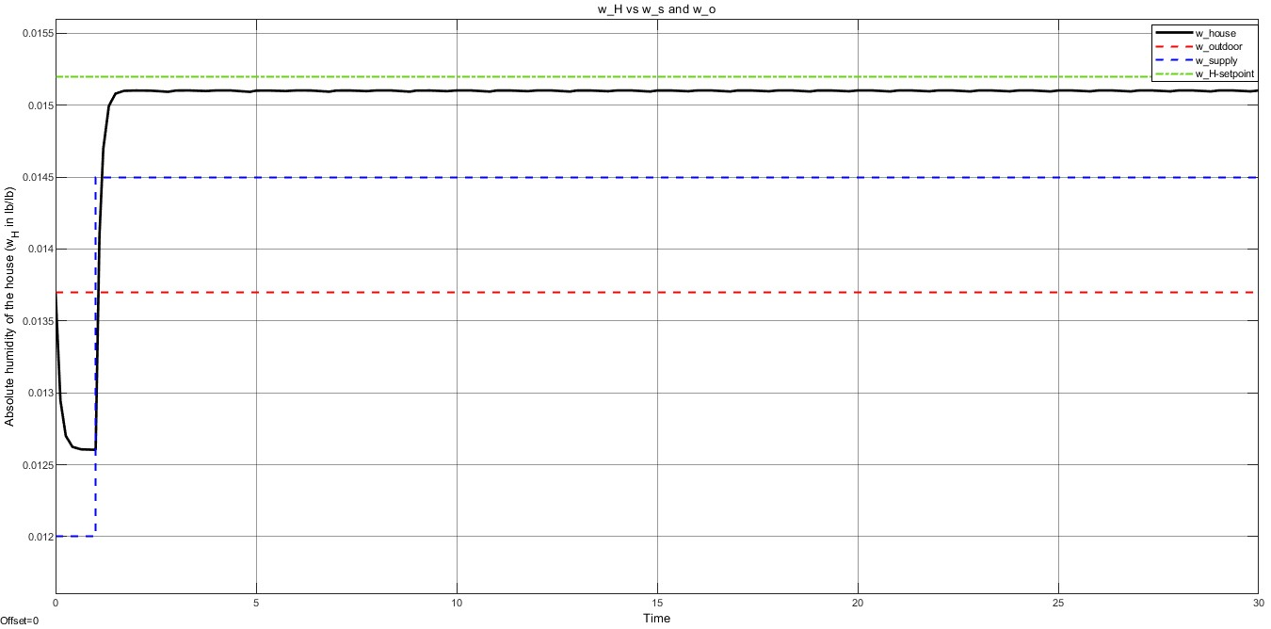
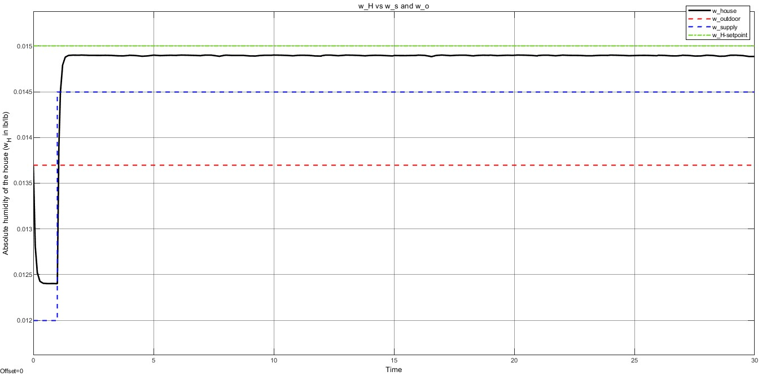
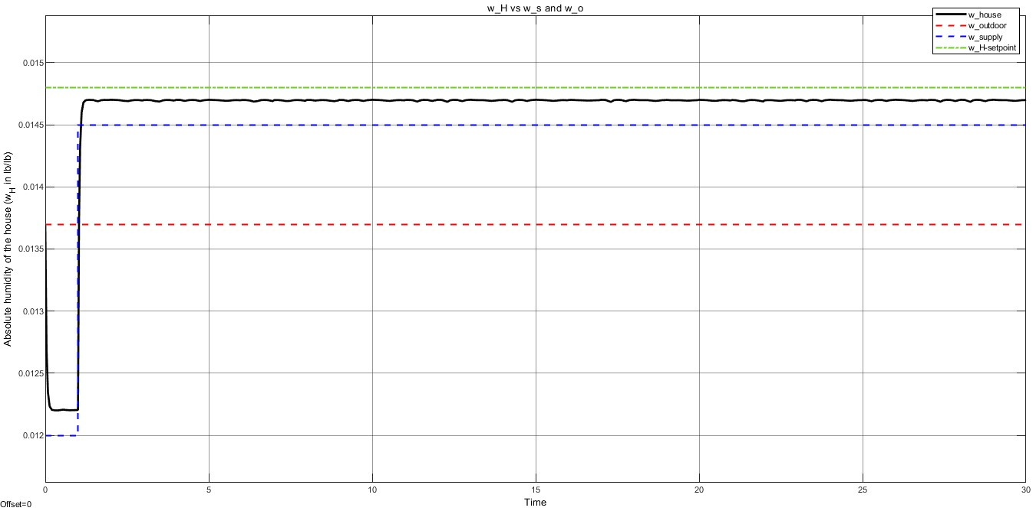
Results and Discussion – Closed-Loop Model W_{H} Responses
W_{H} responses for setpoint and disturbance changes
(B) Increased W_{set}
(A) Base Line
Fig 21. Open-Loop Model Response to W_{set} changes (A) Base Model (From Annual conditions data) (B) Increased W_{set} (C) Decreased W_{set}
(C) Decreased W_{set}

Slide 23
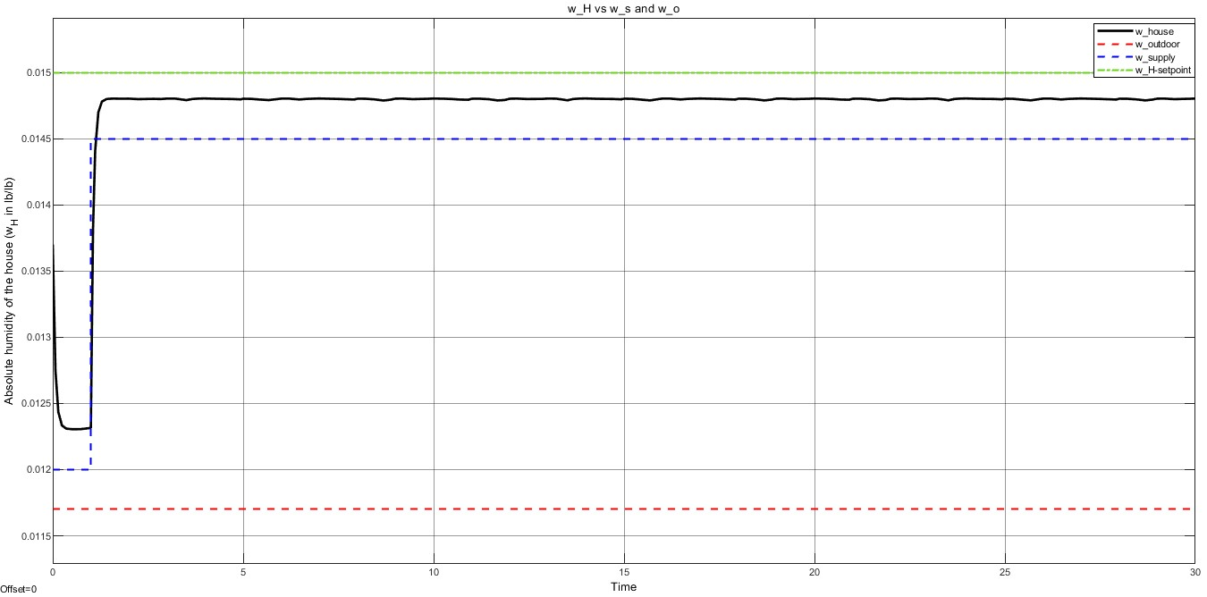
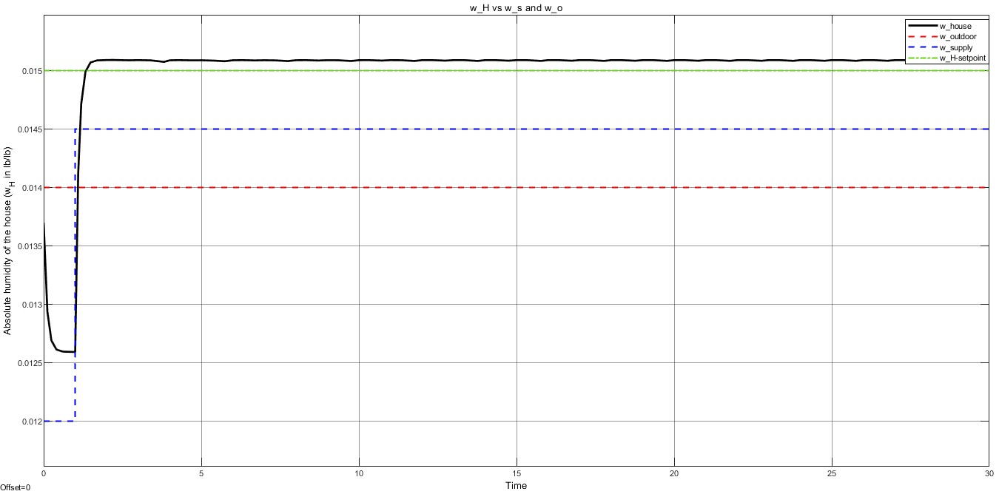
Results and Discussion – Closed-Loop Model W_{H} Responses (CONT’D)
W_{H} responses for setpoint and disturbance changes
(B) Increased W_{O}
(A) Base Line
Fig 22. Closed-Loop Model Response to W_{o} changes (A) Base Model (From Annual conditions data) (B) Increased W_{o} (C) Decreased W_{o}
(C) Decreased W_{O}

Slide 24
Results and Discussion – Economic, Sustainability & Innovation Comparison
Rubric: 1 – Very Low 2 – Low 3 – Normal 4 – High 5 – Very High
Factor | Standard AC | Proposed | Reason
Operational Cost | High | Very Low | Typical low maintenance costs for EC systems. Main fluid in the governing process is water. Low electrical consumption for Desiccant Wheel (DW) and blower motors because of the very low RPM needed.
Emissions/ Environment Concerns | Very High | Very Low | Lower energy usage, thus contributing to a lower carbon footprint. A typical evaporation cooling unit has been found to be capable of reducing C0₂ emissions by up to 80% [8]. No hydrocarbon-based coolants being released into the environment.
Innovative Factor | Normal | High | Proposed system with Temperature and Humidity control will be a novel system on the market.

Slide 25
Conclusion and Future Recommendations
In Conclusion,
Developed a residential thermal dynamics model for control of temperature and humidity.
Introduced an adaptable EC/DW MIMO system for residential spaces, suitable for diverse climates.
Conducted a comparison and assessment, revealing significant benefits to energy and sustainability compared to vapor-compression AC systems
Future Recommendations
Explore proposed system integration with renewable energy sources, further enhancing sustainability.
Research advanced materials and technologies for improved efficiency and durability of the EC/DW system.
A more in-depth search into control hardware to implement ANN model

Slide 26
References
[1] P. M. Cuce, S. Riffat, "A state of the art review of evaporative cooling systems for building applications," Renew. Sustain. Energy Rev., vol. 54, pp. 1240-1249, 2016. [Online]. Available: https://doi.org/10.1016/j.rser.2015.10.066.
[2] "Evaporative cooling... The rationale evaporates," Electrical Connection, Jul. 30, 2015. [Online]. Available: https://electricalconnection.com.au/evaporative-cooling-the-rationale-evaporates/.
[3] F. J. D. I. Dale, E. Seborg, T. F. Edgar, D. A. Mellichamp, "Process Dynamics and Control," 4th ed. Wiley India Pvt. Limited, 2016.
[4] S. J. Qin and T. A. Badgwell, "A survey of industrial model predictive control technology," Control engineering practice, vol. 11, no. 7, pp. 733-764, 2003.
[5] K. Daou, R. Z. Wang, Z. Z. Xia, "Desiccant cooling air conditioning: a review," Renewable and sustainable energy reviews, vol. 10, no. 2, pp. 55-77, 2006.
[6] B. Riangvilaikul and S. Kumar, "An experimental study of a novel dew point evaporative cooling system," Energy and Buildings, vol. 42, no. 5, pp. 637-644, 2010.
[7] C. X. Jia, Y. J. Dai, J. Y. Wu, R. Z. Wang, "Use of compound desiccant to develop high performance desiccant cooling system," International journal of refrigeration, vol. 30, no. 2, pp. 345-353, 2007.
[8] G. Heidarinejad and H. Pasdarshahri, "Potential of a desiccant-evaporative cooling system performance in a multi-climate country," International Journal of Refrigeration, vol. 34, no. 5, pp. 1251-1261, 2011.
[9] M. M. Rafique, P. Gandhidasan, S. Rehman, L. M. Al-Hadhrami, "A review on desiccant based evaporative cooling systems," Renewable and Sustainable Energy Reviews, vol. 45, pp. 145-159, 2015.
[10] D. B. Jani, M. Mishra, P. K. Sahoo, "Solid desiccant air conditioning–A state of the art review," Renewable and Sustainable Energy Reviews, vol. 60, pp. 1451-1469, 2016.
[11] P. Yost, "How Active Dehumidification Works," BuildingGreen, Sep. 3, 2013. [Online]. Available: https://www.buildinggreen.com/primer/how-active-dehumidification-works.
[12] Y. Lee, S. Park, S. Kang, "Performance analysis of a solid desiccant cooling system for a residential air conditioning system," Appl. Therm. Eng., vol. 182, p. 116091, 2021, [Online]. Available: [doi: 10.1016/j.applthermaleng.2020.116091](doi: 10.1016/j.applthermaleng.2020.116091).
[13] A. K. Verma, L. Yadav, N. Kumar, A. Yadav, "Mathematical investigation of different parameters of the passive desiccant wheel," Numer. Heat Transf. Part A Appl., vol. 0, no. 0, pp. 1-20, 2023, [Online]. Available: [doi: 10.1080/10407782.2023.2172491](doi: 10.1080/10407782.2023.2172491).
[14] G. Harriman, M. J. Witte, A. Czachorsk, D. R. Kosar, "Evaluating active desiccant systems for ventilating commercial buildings," ASHRAE J., vol. 41, no. 10, pp. 28-37, 1999.

Slide 27
Thank you!

Slide 28
Appendix A – Files & Video Presentation link
Video
https://uthsct.sharepoint.com/sites/ProcessControlCourseProject/Shared%20Documents/General/Recordings/Meeting%20in%20_General_-20231207_231634-Meeting%20Recording.mp4?web=1
Simulink and MATLAB models
Open and closed loop models
All relevant project documents
Project documents

Slide 29
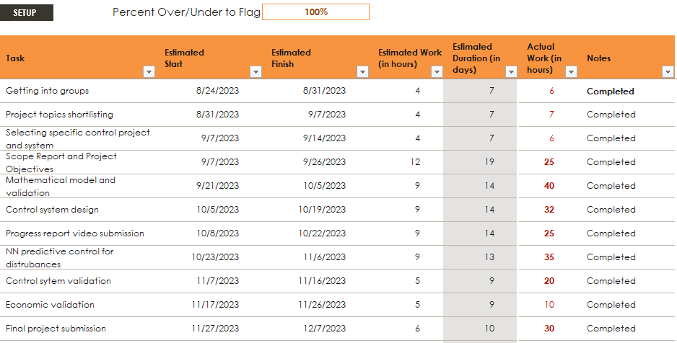
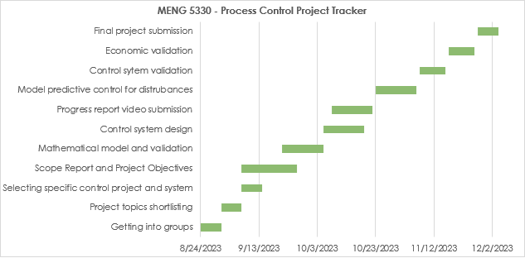
Appendix B – Gantt Chart

Slide 30
Appendix C – New Relevant Changes Made from Progress Report
Changes Based On Instructor Feedback
Implemented ANN Empirical Model
References were modified completely to meet IEEE referencing style standards
Clearly defined inputs and references in response plots
Graphs labels are shown
Contents in Results and Methodology slides from previous report have been rectified
Changes / Additions Based On Project Objectives and Team’s Preferred Changes
New plant model based on ODE with Initial conditions
Energy savings assessment and comparison between standard AC system and Proposed EC/DW system.
Future Recommendations on Project
Changes Completed As Project Requirements
Implemented ANN Empirical Model
Perform the controller design with appropriate assumptions
Completed a quality oral video report

Slide 31

Appendix D – Video Check List

Slide 32
Appendix E - Methodology (System Schematic)
Heat Recovery
Ventilator (HRV)
Evaporative
Cooler (EC)
PROPOSED EC AND DW AC SYSTEM
Desiccant Wheel (DW)
(1-2) Dehumidification by DW
(2-3) Sensible Heat Exchange
(3-4) Direct Evaporative Cooling
(4-5) Conditioned Space Cooling
After Recirculation
(5-6) Sensible Heat Exchange
(6-7) Gas Furnace Air heating
(7-8) DW regeneration with Hot Dry Air
(1)
(2)
(3)
(4)
Occupied Space
(8)
(7)
(5)
(6)
Gas Furnace
1 – Outdoor air
2 – Dry air
3 – Cool dry air
4 – Cold humid air into room
5 – Cool humid air exhaust
6 – Mild heated less humid air
7 – Hot dry air from furnace
8 – Hot humid air

Slide 33
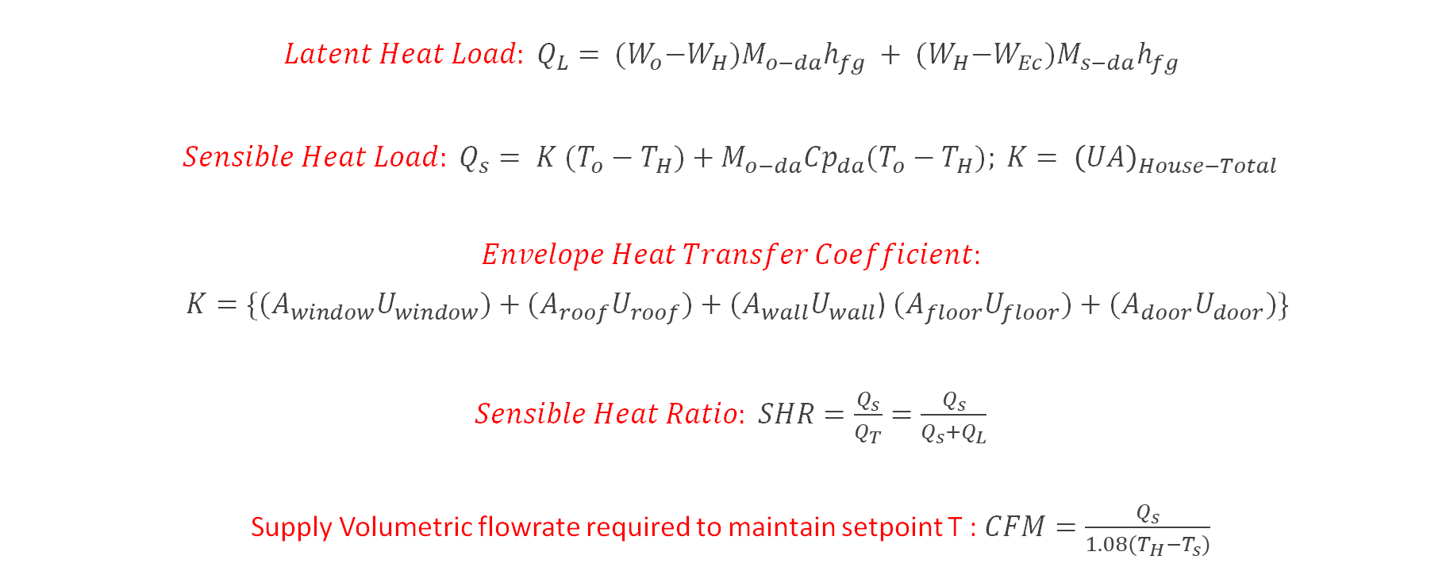
Appendix F - Methodology (Load Calculations of Space)
${Latent Heat Load: Q}_{L}= {(W}_{o}−W_{H})M_{o−da}h_{fg} + {(W}_{H}−W_{Ec})M_{s−da}h_{fg}$
${Sensible Heat Load: Q}_{s}= {K (T}_{o}−T_{H})+{M_{o−da}{Cp}_{da}(T}_{o}−T_{H}); K= {\left(UA\right)}_{House−Total}$
$Envelope Heat Transfer Coefficient$:
${ K=\{(A}_{window}U_{window})+{(A}_{roof}U_{roof})+$ ${(A}_{wall}U_{wall}$) ${(A}_{floor}U_{floor})+$ ${(A}_{door}U_{door})\}$
$Sensible Heat Ratio: SHR=\frac{Q_{s}}{Q_{T}}=\frac{Q_{s}}{Q_{s}+Q_{L}}$
Supply Volumetric flowrate required to maintain setpoint T : $CFM=\frac{Q_{s}}{{1.08(T_{H}−T}_{s})}$

Slide 34





Appendix G - Methodology (Dynamic Model of Space)
Dynamic Dry air energy equation
$\frac{d\left(ρVCp−da T\right)}{dt}=K\left(T_{o}−T_{H}\right)+M_{s−da}h_{s}+M_{o−da}h_{o}− m_{r−da}h_{H}$
Equations depict the energy balance in residential spaces, encompassing thermal energy from dry air and water vapor in supply, return, and outdoor air streams.
Q represents sensible heat transferred into the system via building envelope conduction..
$$\frac{dT_{H}}{dt}=\frac{1}{ρ_{da}∀_{H}{Cp}_{da}}\left(k\left(T_{o}−T_{H}\right)+\dot{m_{s−da}}{Cp}_{da}T_{s}+\dot{m_{o−da}}{Cp}_{da}T_{o}−\dot{m_{r−da}}{Cp}_{da}T_{H}\right)$$
For Temperature,
$${\% Error }_{steady−state}=2.65\%$$
Dynamic Water vapor energy equation
$$\frac{d\left(ρVWh_{w}\right)}{dt} =M_{s−da}w_{s }h_{w}+M_{o−da}w_{o}h_{o}h_{w}−m_{r−da}w_{r}h_{w}$$
$$\frac{dw_{H}}{dt}=\frac{1}{ρ_{w}∀_{H}}\dot{(\left(m_{s−da}\right)w_{s}+\dot{m_{o−da}}w_{o}−\dot{m_{r−da}}w_{H}) }$$
For Humidity,
$${\% Error }_{steady−state}=4.04\%$$

Slide 35

Appendix H – Development of Process ANN Model
A. Plant is trained with three set of data for three different scenarios.
Firstly, data set for scenario 1st is trained using 10 neurons using “trailm” function
Secondly, trained model with scenario 1st data set again trained with data set for scenario 2nd using 20 neurons
Finally, the 2nd trained model is again trained with data set for scenario 3rd using 30 neurons
B. Steps for Training and Model Development
Configure settings for Plant scenario
Import Data (Generated from ODEs)
Train Network
Validation
Appendix Fig. 1: Plant Identification configuration

Slide 36




APPENDIX J – OVERALL DIAGRAM AND PERFORMANCE
Appendix Fig 2. Neural Network Diagram Temperature (T)
Appendix Fig.3 Neural Network Diagram Humidity (W)

Slide 37

Appendix K – NN PC Configuration
Time of Predictions (s)
Maximum and Minimum Plant input (Ts) range is based on the EC max capacity for minimum and SHR line to maintain Ts.
Cost Horizon – Time of predictions
Control Horizon – Number of times you want to optimize your control (CFM) within cost horizon
Weight Factor – 0 (Closer to setpoint) – 1 (Energy Savings)
# of optimization iterations for CFM control
Range: 0 to 1
Appendix Fig. 4 NN PC Configuration Box

Slide 38

Appendix L – Evaporative capacity formula (EC)
Type in Ts as a function of CFM.
$T_{s}=T_{EC,in}−\frac{Q_{cap}}{1.008∗∀_{H}}$
Where, $Q_{cap}$ cooling capacity of evaporative cooler
$∀_{H}$ volume of house

Slide 39
Appendix M – Desiccant wheel humidity removal function (DW)
The equation of the plot relates the humidity entering the system to the rpm of the desiccant wheel
Appendix Fig.5 Process outlet Plot for Humidity

Slide 40

Appendix N – Sensor/ Transmitter Technical Data
Measuring range
Relative Humidity (RH) 0...100 %RH, non-condensing
Temperature (T) -30...+60 °C (-22...+140 °F)
Outputs
Temperature 0 - 10 V
Relative Humidity (RH) 4 - 20 mA (2-wire)
NB: Ranges of temperature and humidity control from technical data is utilized in calculating the gain of Sensor. Shown in subsequent slide.
Appendix Fig. 6 Sensor Type for Technical Data for Proposed System

Slide 41


PID Controller tuning
To tune the PID controllers, gains, ti, and td constants were given from open-loop responses using Ziegler Nichols method.
Appendix Fig. 6 Ziegler-Nichols Tuning parameter table
Appendix Fig. 7 PID Controller tuning parameters input window

Slide 42

Closed-loop using PID control

